Slide 1
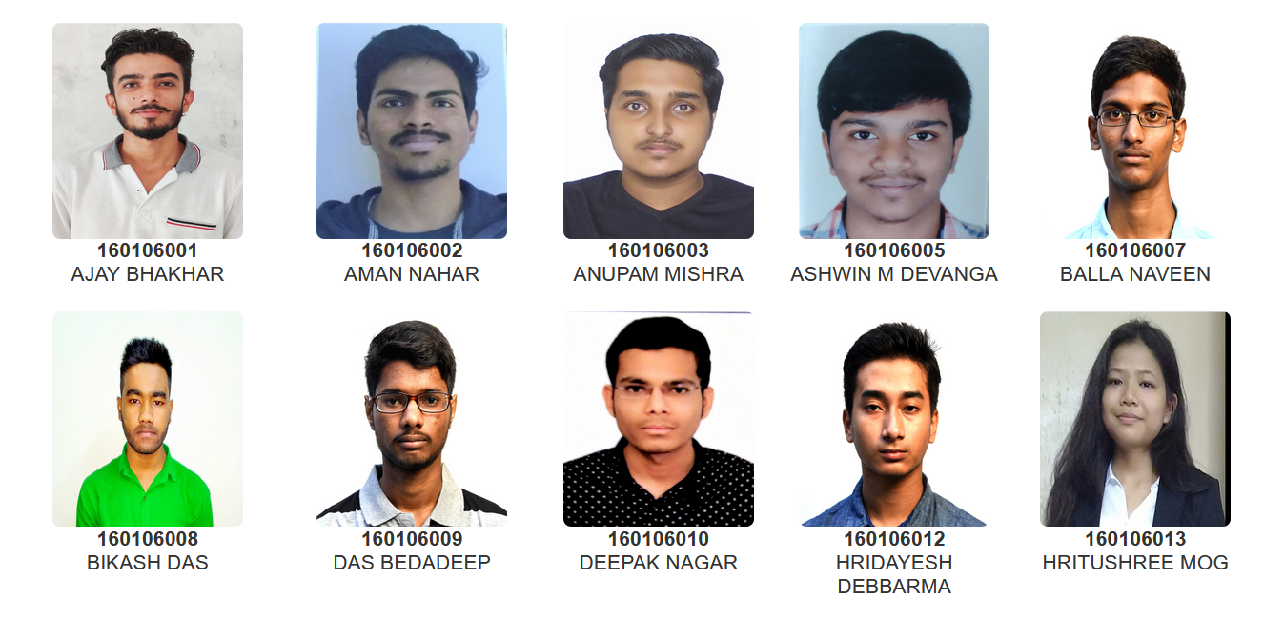
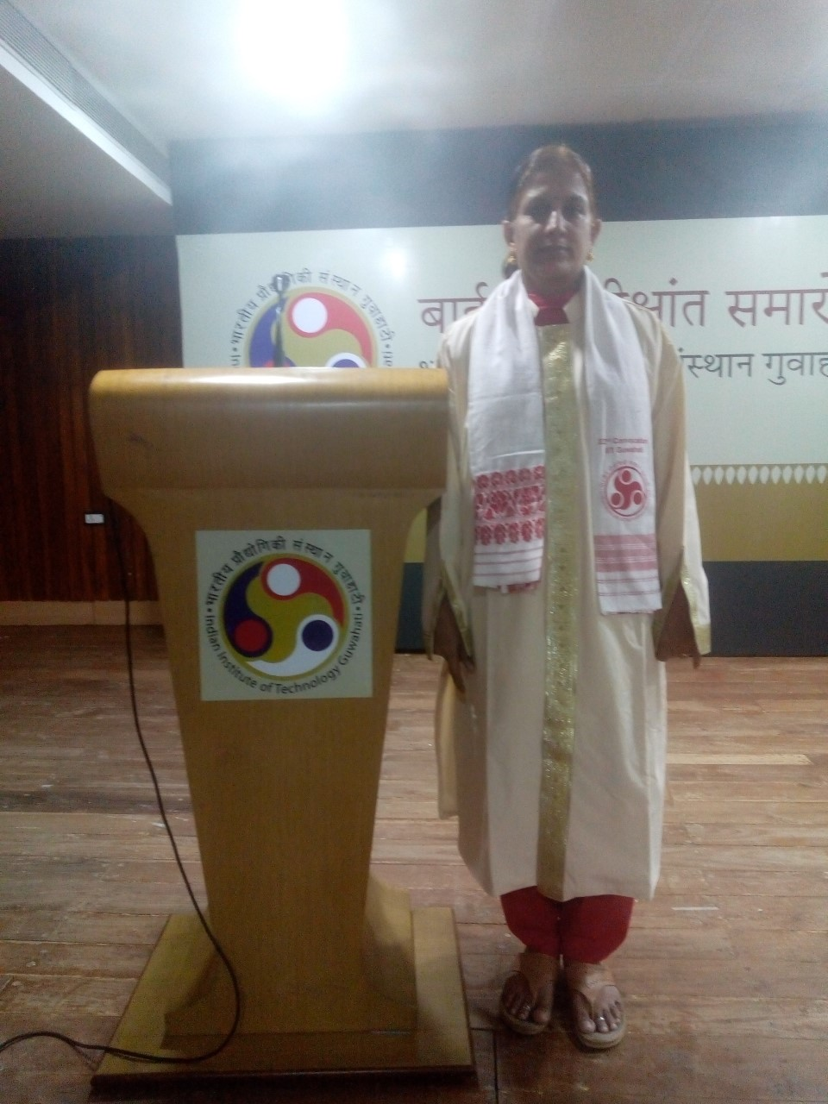
Head Of the Department
Prof. Latha Rangan
B.Tech.(Department of Biosciences and Bioengineering)

Slide 2
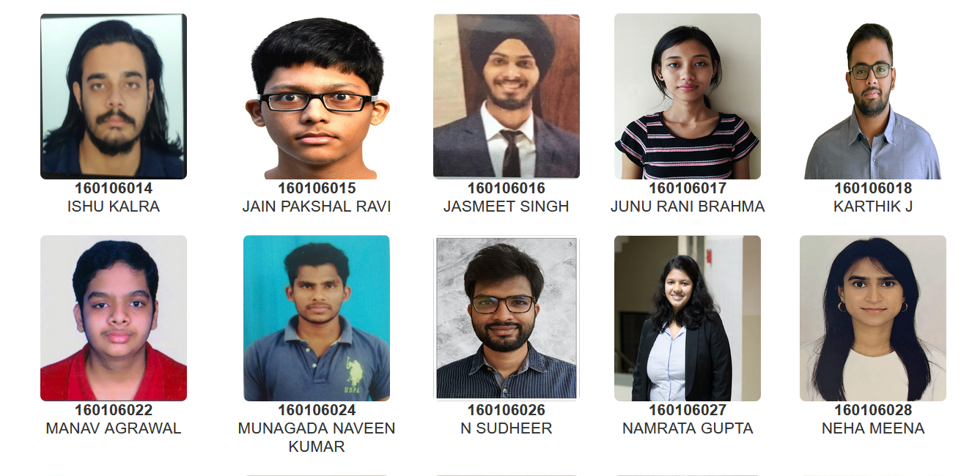
Head Of the Department
Prof. Latha Rangan
B.Tech.(Department of Biosciences and Bioengineering)

Slide 3
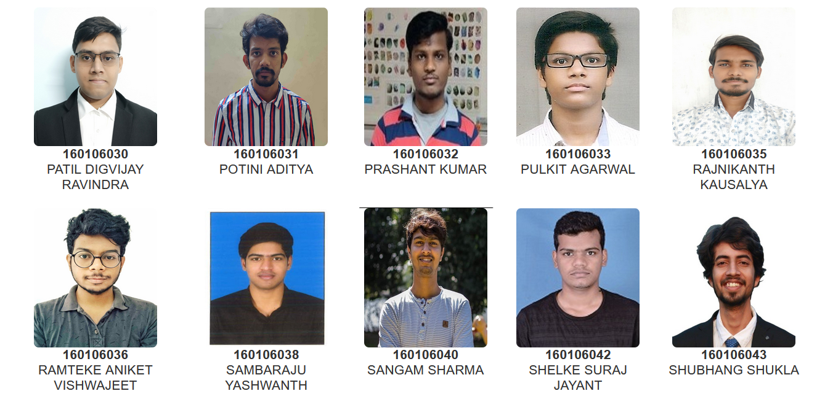
Head Of the Department
Prof. Latha Rangan
B.Tech.(Department of Biosciences and Bioengineering)

Slide 4
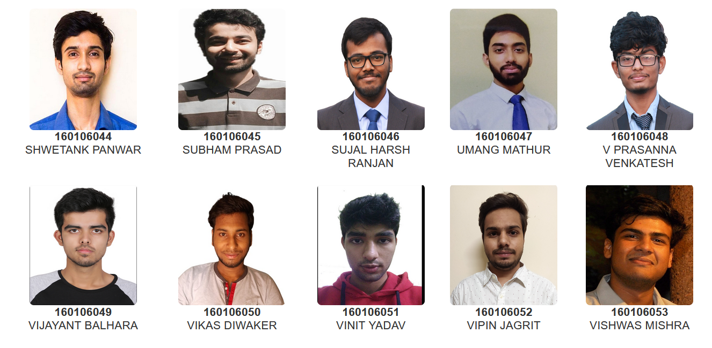
Head Of the Department
Prof. Latha Rangan
B.Tech.(Department of Biosciences and Bioengineering)

Slide 5
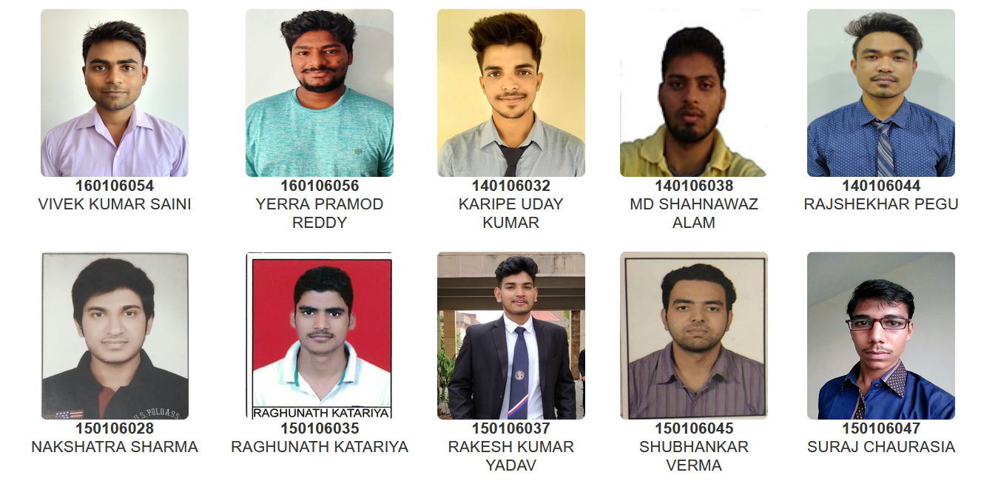
Head Of the Department
Prof. Latha Rangan
B.Tech.(Department of Biosciences and Bioengineering)

Slide 6
Head Of the Department
Prof. Latha Rangan
B.Tech.(Department of Biosciences and Bioengineering)

