Slide 1
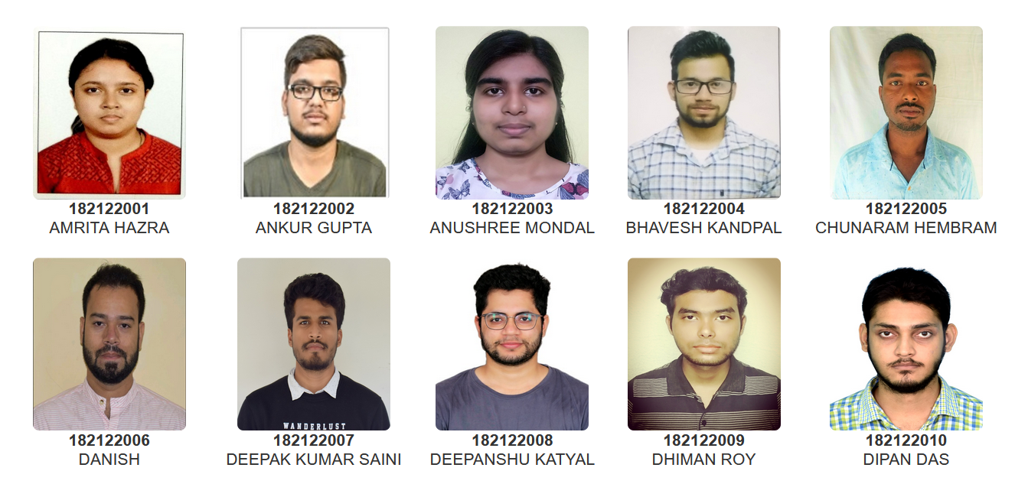
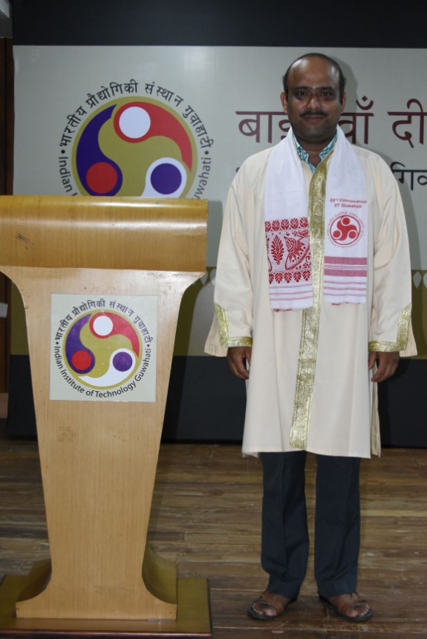
Head Of the Department
Prof. Gopal Das
M.Sc. (Department of Chemistry)

Slide 2
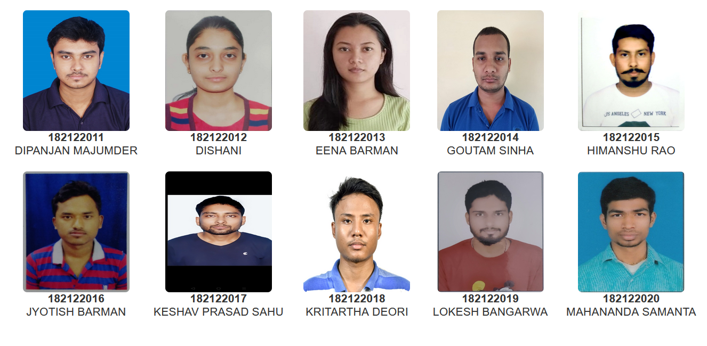
Head Of the Department
Prof. Gopal Das
M.Sc. (Department of Chemistry)

Slide 3
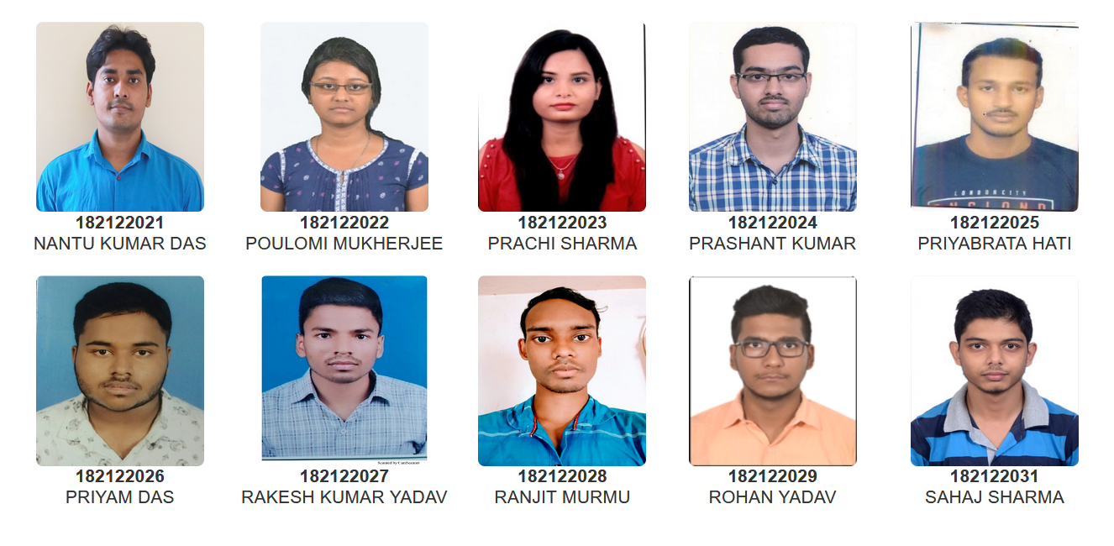
Head Of the Department
Prof. Gopal Das
M.Sc. (Department of Chemistry)

Slide 4
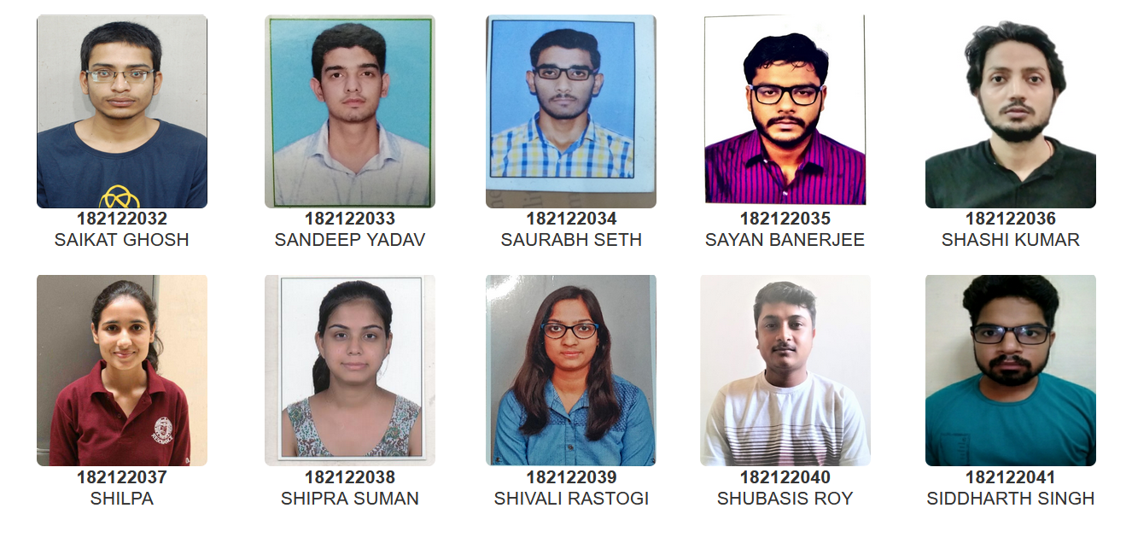
Head Of the Department
Prof. Gopal Das
M.Sc. (Department of Chemistry)

Slide 5
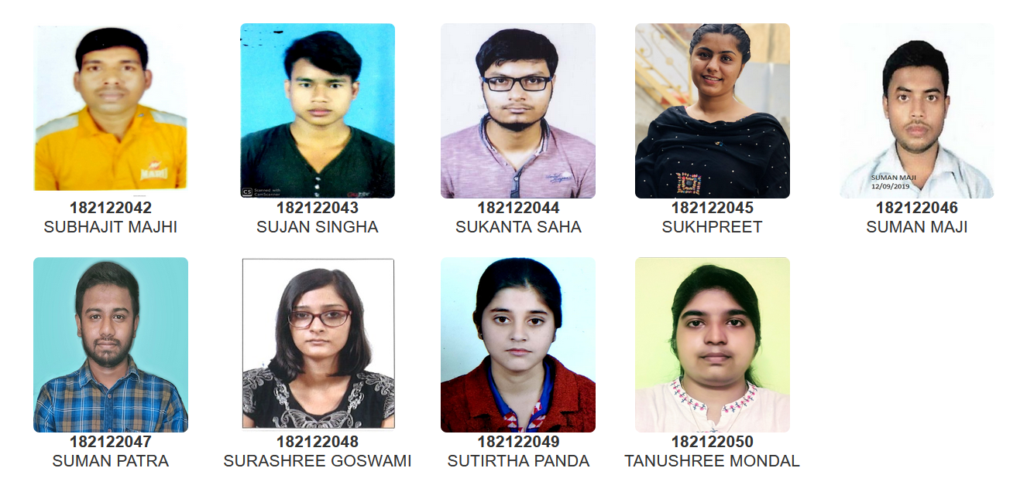
Head Of the Department
Prof. Gopal Das
M.Sc. (Department of Chemistry)

