Slide 1
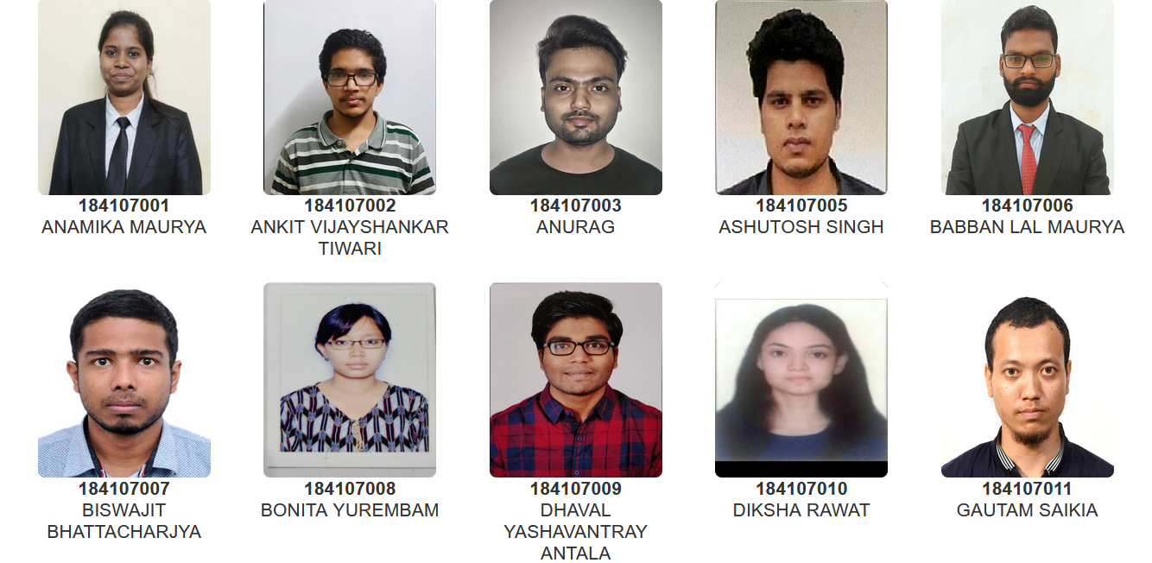
Head Of the Department
Prof. Anugrah Singh
M.Tech. (Department of Chemical Engineering)

Slide 2
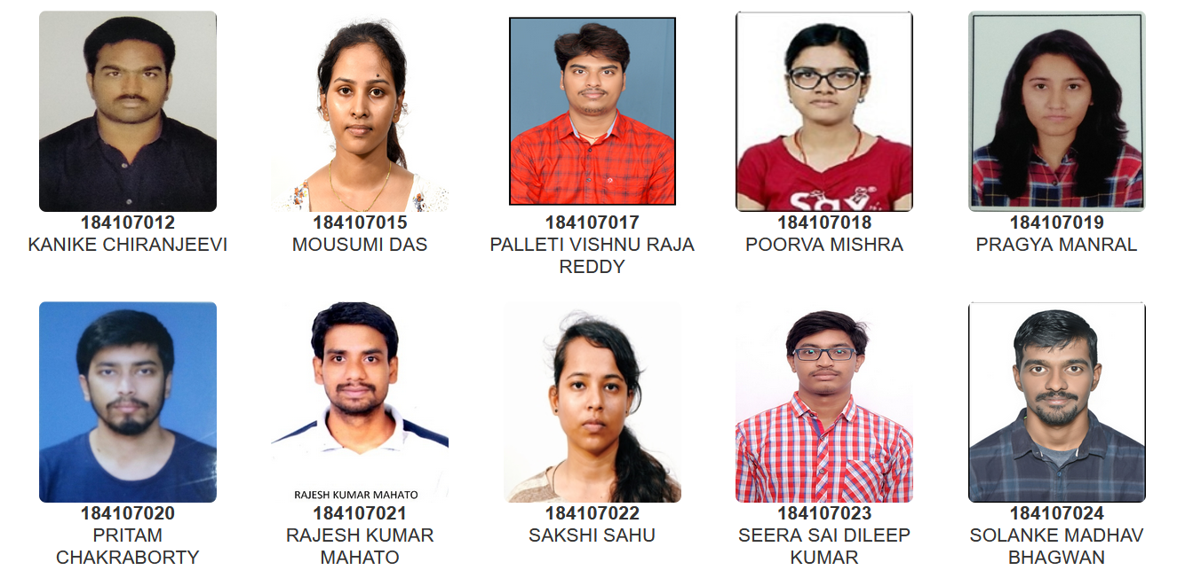
Head Of the Department
Prof. Anugrah Singh
M.Tech. (Department of Chemical Engineering)

Slide 3
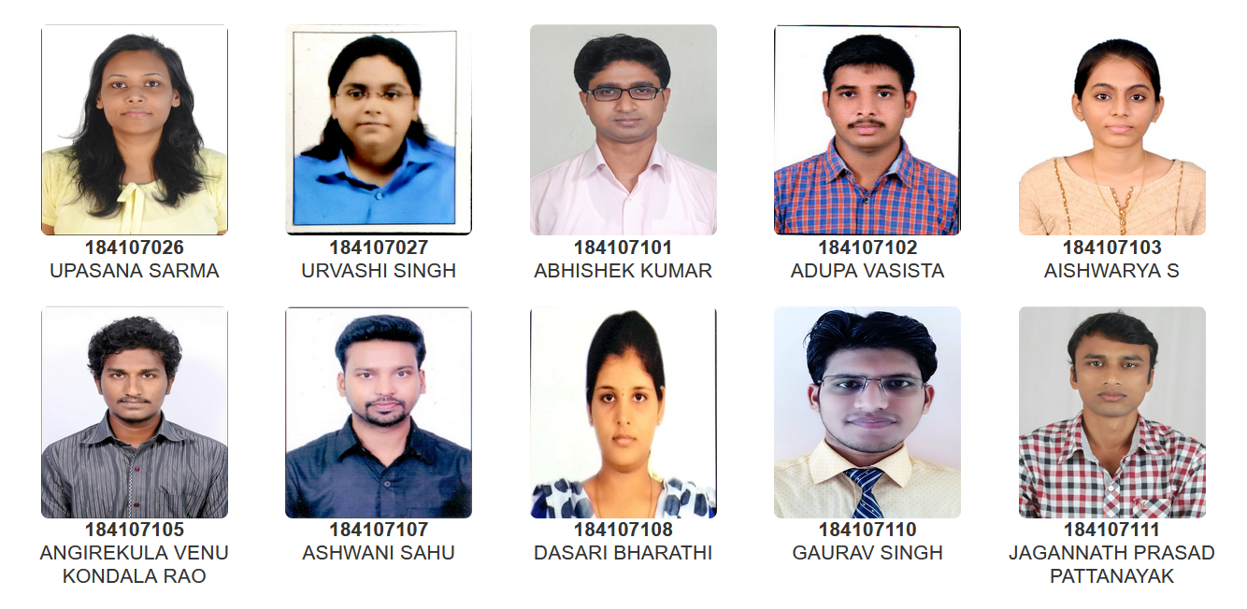
Head Of the Department
Prof. Anugrah Singh
M.Tech. (Department of Chemical Engineering)

Slide 4
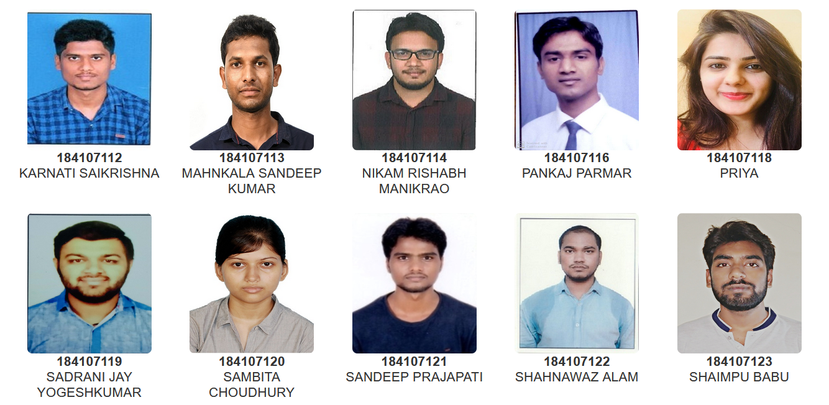
Head Of the Department
Prof. Anugrah Singh
M.Tech. (Department of Chemical Engineering)

Slide 5
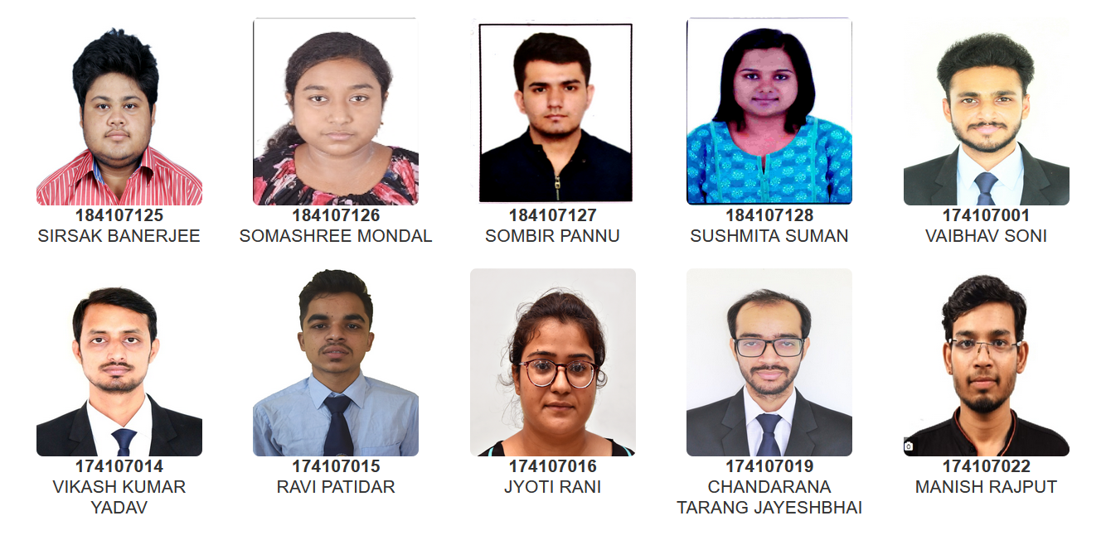
Head Of the Department
Prof. Anugrah Singh
M.Tech. (Department of Chemical Engineering)

Slide 6
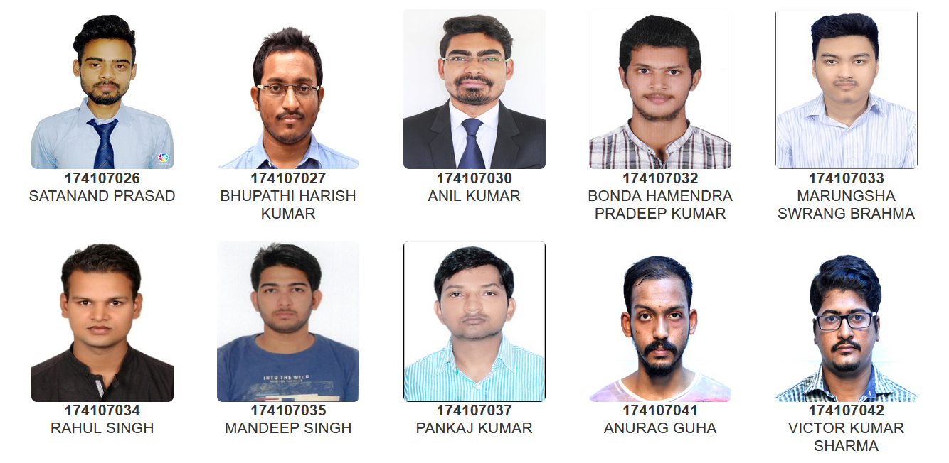
Head Of the Department
Prof. Anugrah Singh
M.Tech. (Department of Chemical Engineering)

Slide 7
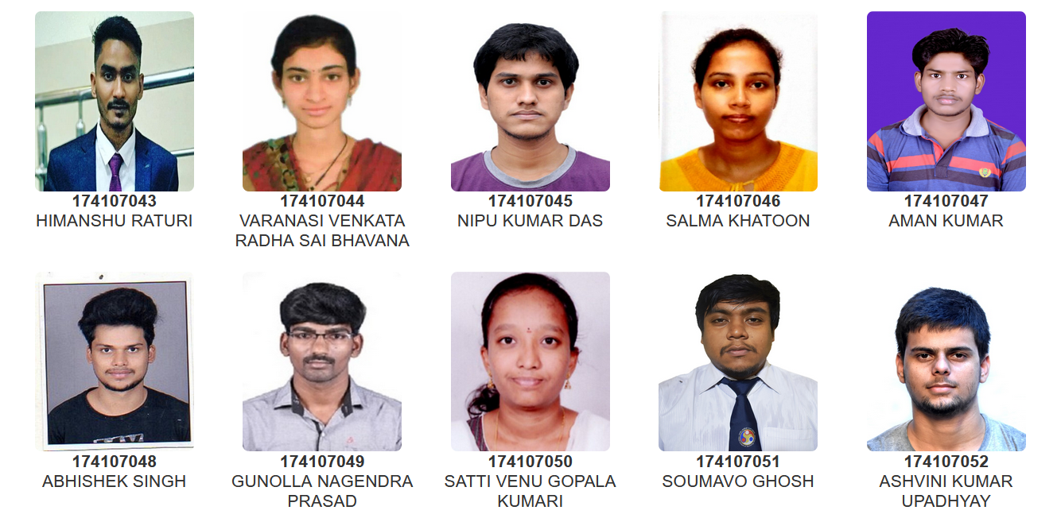
Head Of the Department
Prof. Anugrah Singh
M.Tech. (Department of Chemical Engineering)

Slide 8
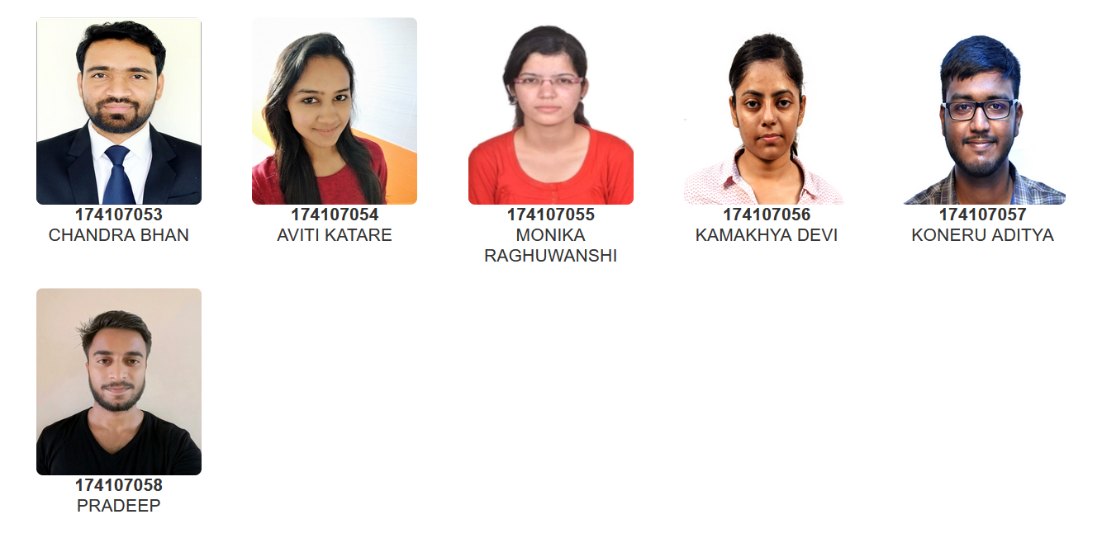
Head Of the Department
Prof. Anugrah Singh
M.Tech. (Department of Chemical Engineering)

