Slide 1
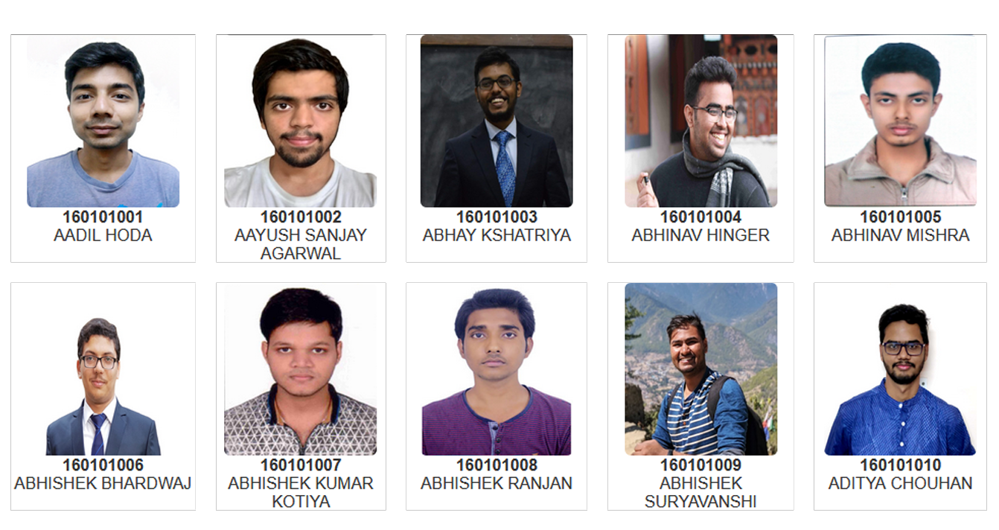
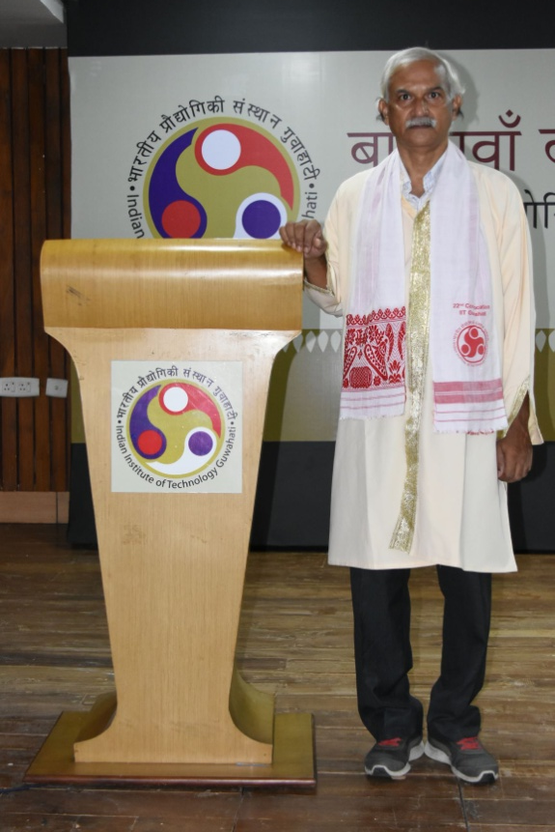
Head Of the Department
Prof. Jatindra Kumar Deka
B.Tech. (Department of Computer Science and Engineering)

Slide 2
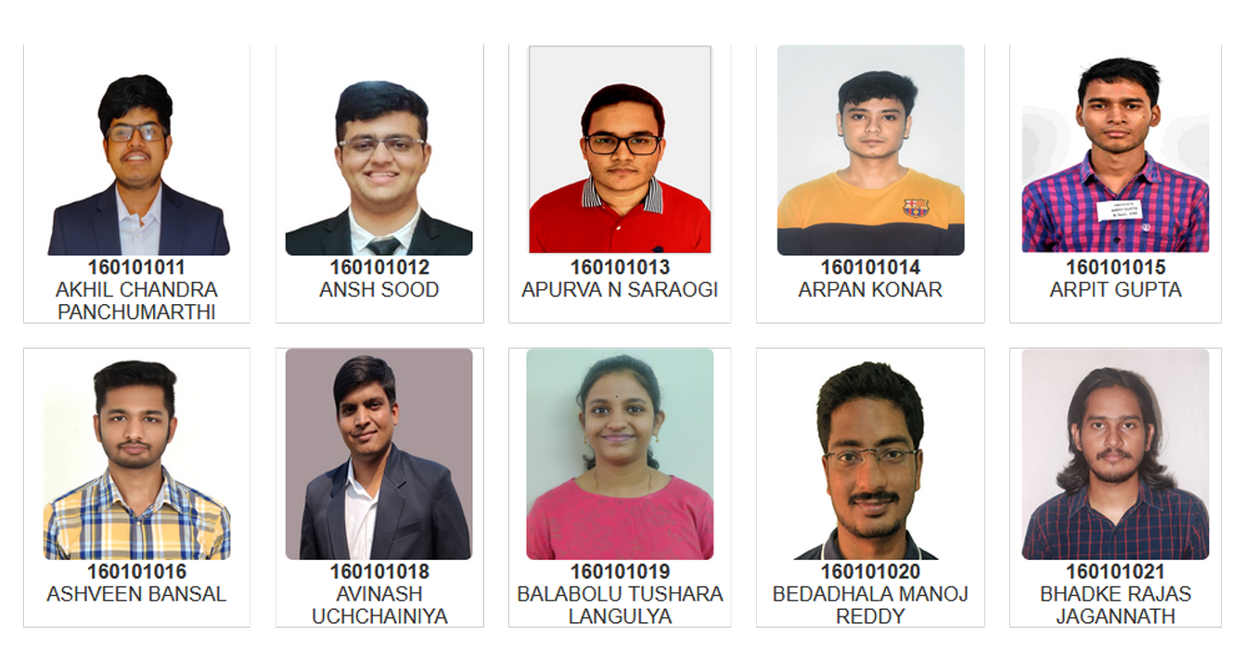
Head Of the Department
Prof. Jatindra Kumar Deka
B.Tech. (Department of Computer Science and Engineering)

Slide 3
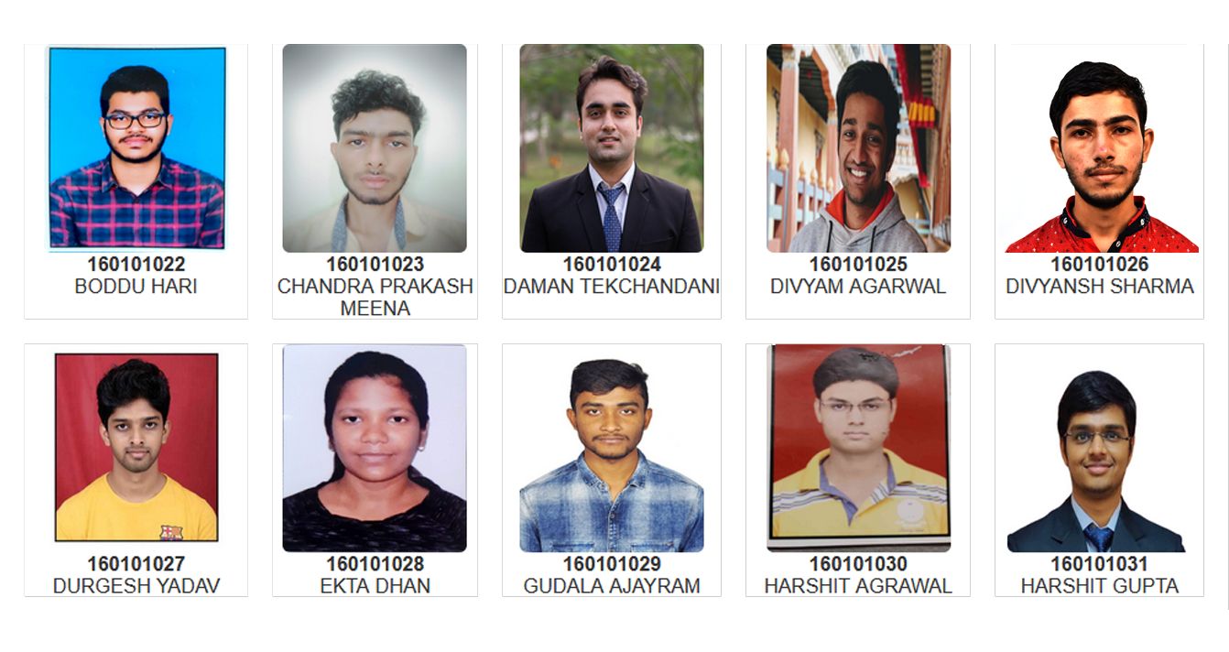
Head Of the Department
Prof. Jatindra Kumar Deka
B.Tech. (Department of Computer Science and Engineering)

Slide 4
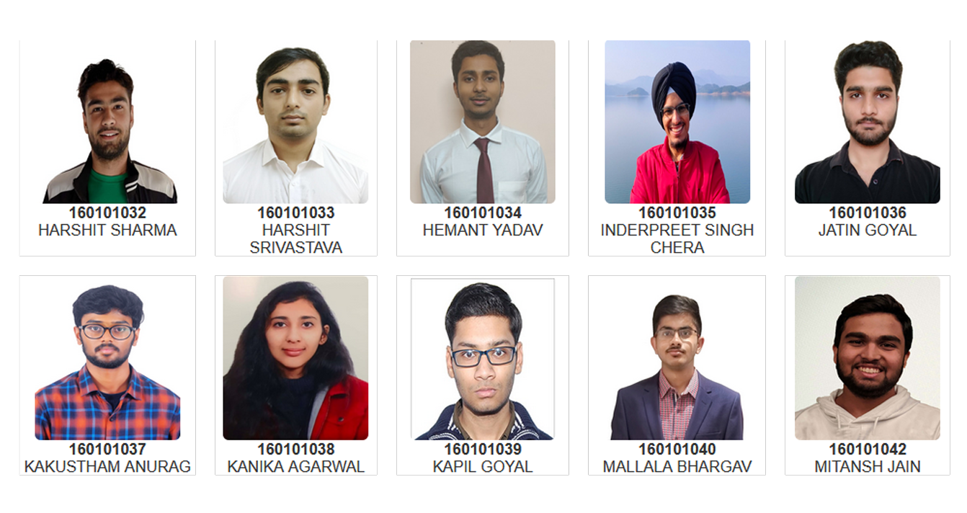
Head Of the Department
Prof. Jatindra Kumar Deka
B.Tech. (Department of Computer Science and Engineering)

Slide 5
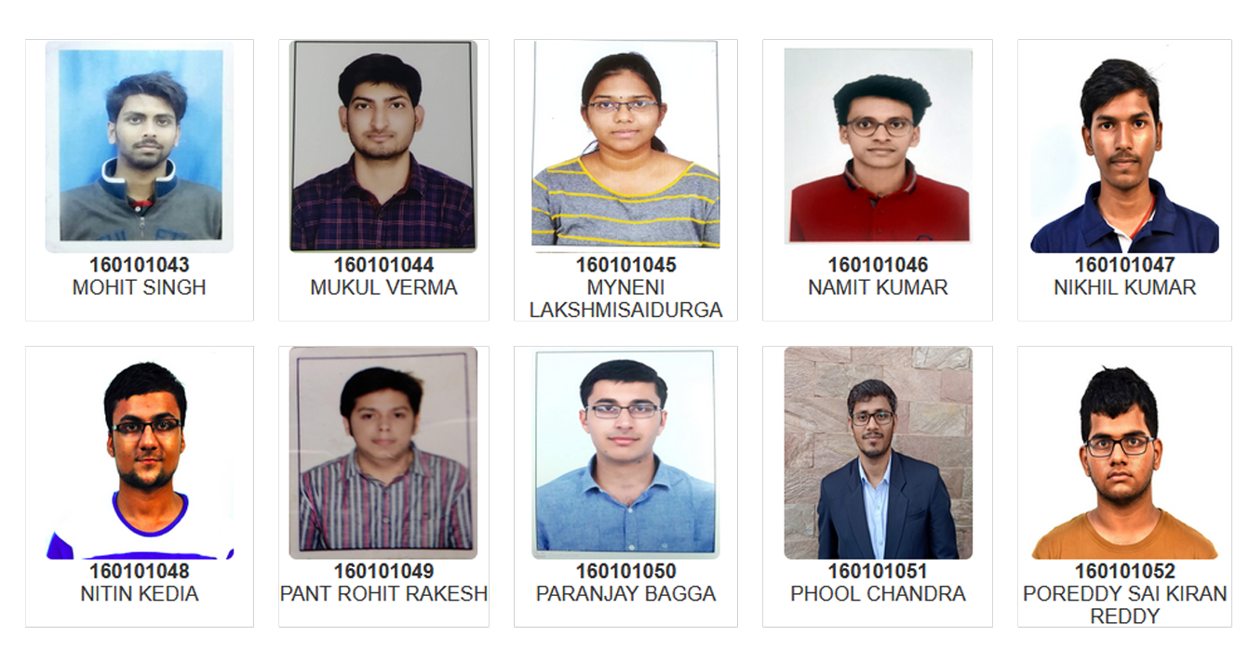
Head Of the Department
Prof. Jatindra Kumar Deka
B.Tech. (Department of Computer Science and Engineering)

Slide 6
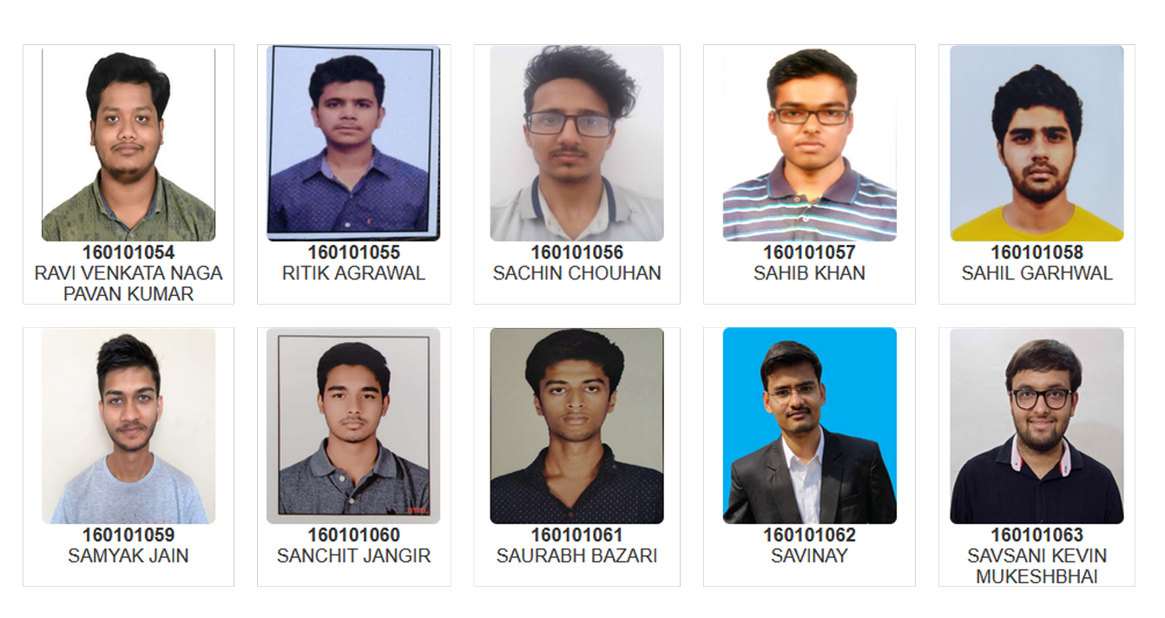
Head Of the Department
Prof. Jatindra Kumar Deka
B.Tech. (Department of Computer Science and Engineering)

Slide 7
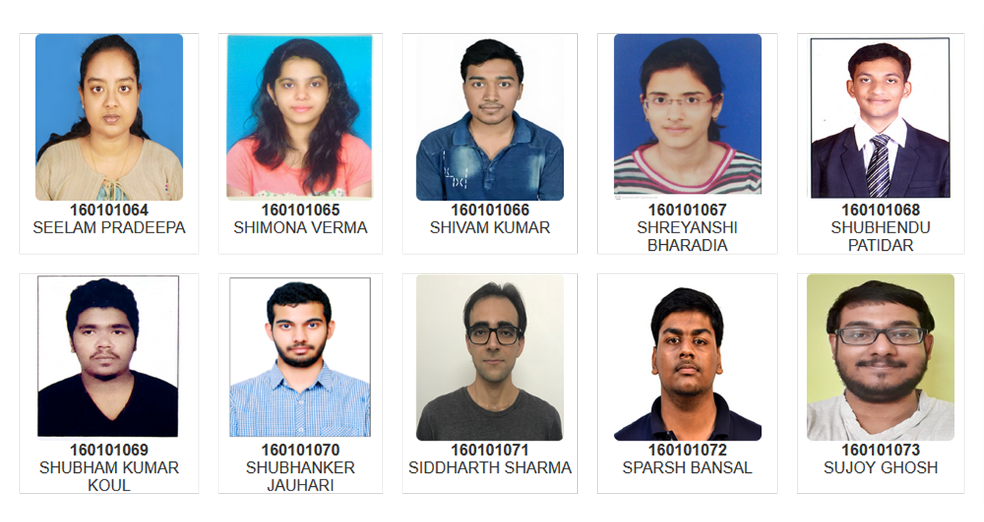
Head Of the Department
Prof. Jatindra Kumar Deka
B.Tech. (Department of Computer Science and Engineering)

Slide 8
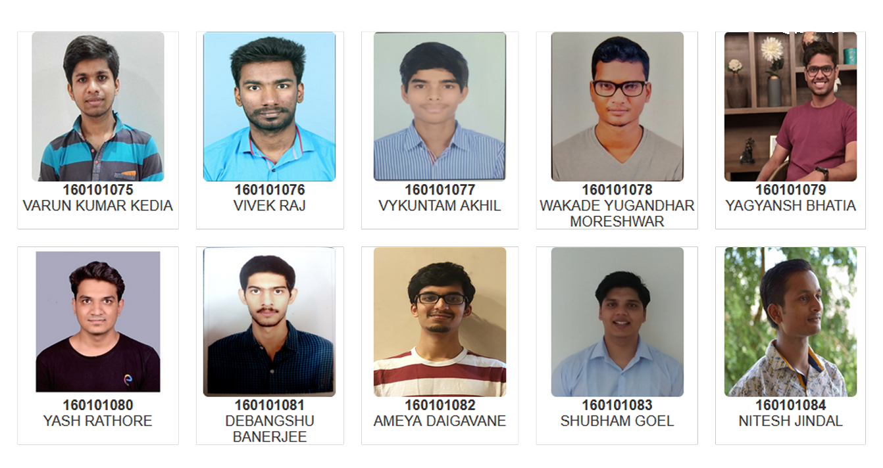
Head Of the Department
Prof. Jatindra Kumar Deka
B.Tech. (Department of Computer Science and Engineering)

Slide 9
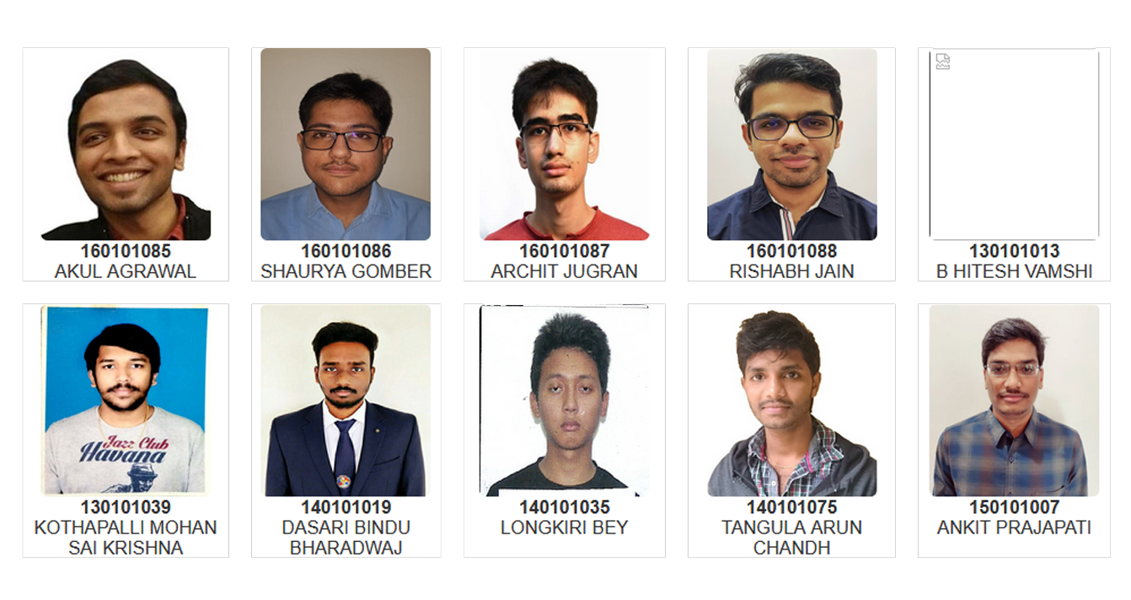
Head Of the Department
Prof. Jatindra Kumar Deka
B.Tech. (Department of Computer Science and Engineering)

Slide 10
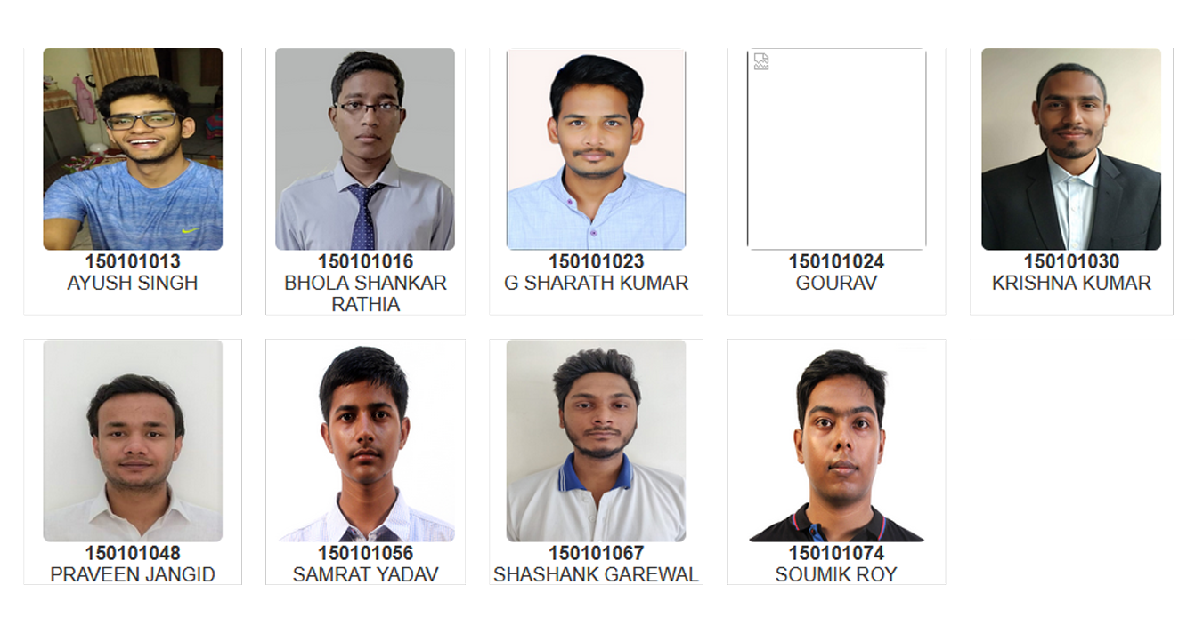
Head Of the Department
Prof. Jatindra Kumar Deka
B.Tech. (Department of Computer Science and Engineering)

