Slide 1
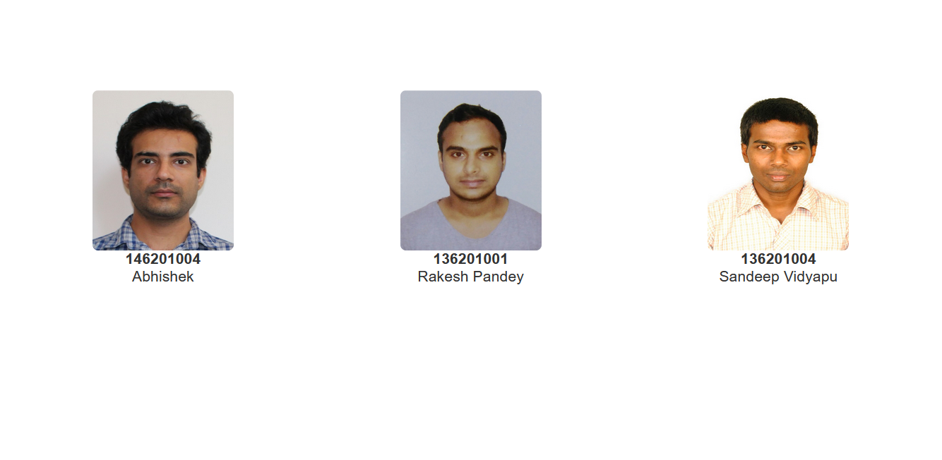
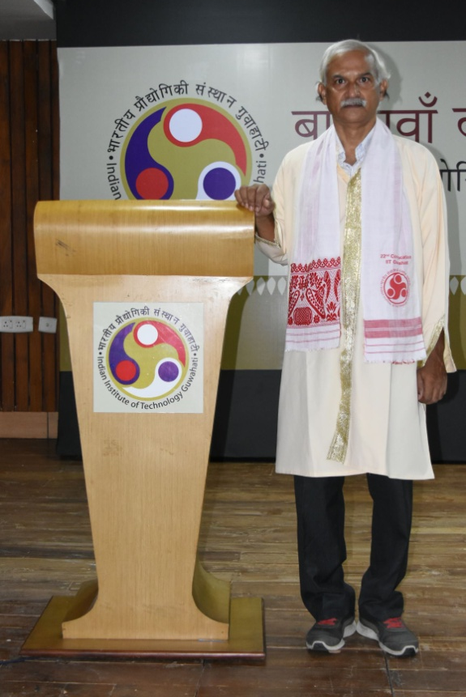
Head Of the Department
Prof. Jatindra Kumar Deka
Dual Degree(M.Tech+PhD) (Department of Computer Science and Engineering)

