Slide 1
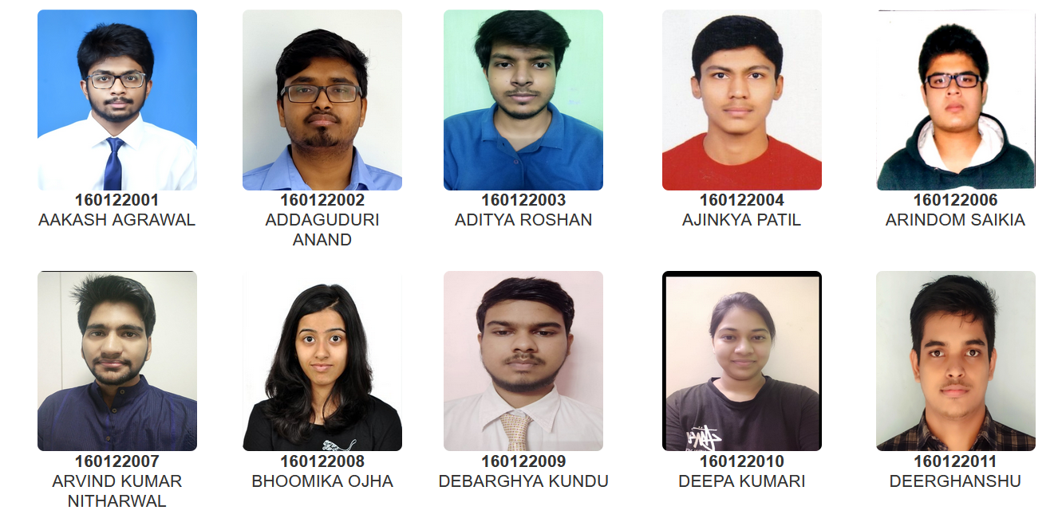
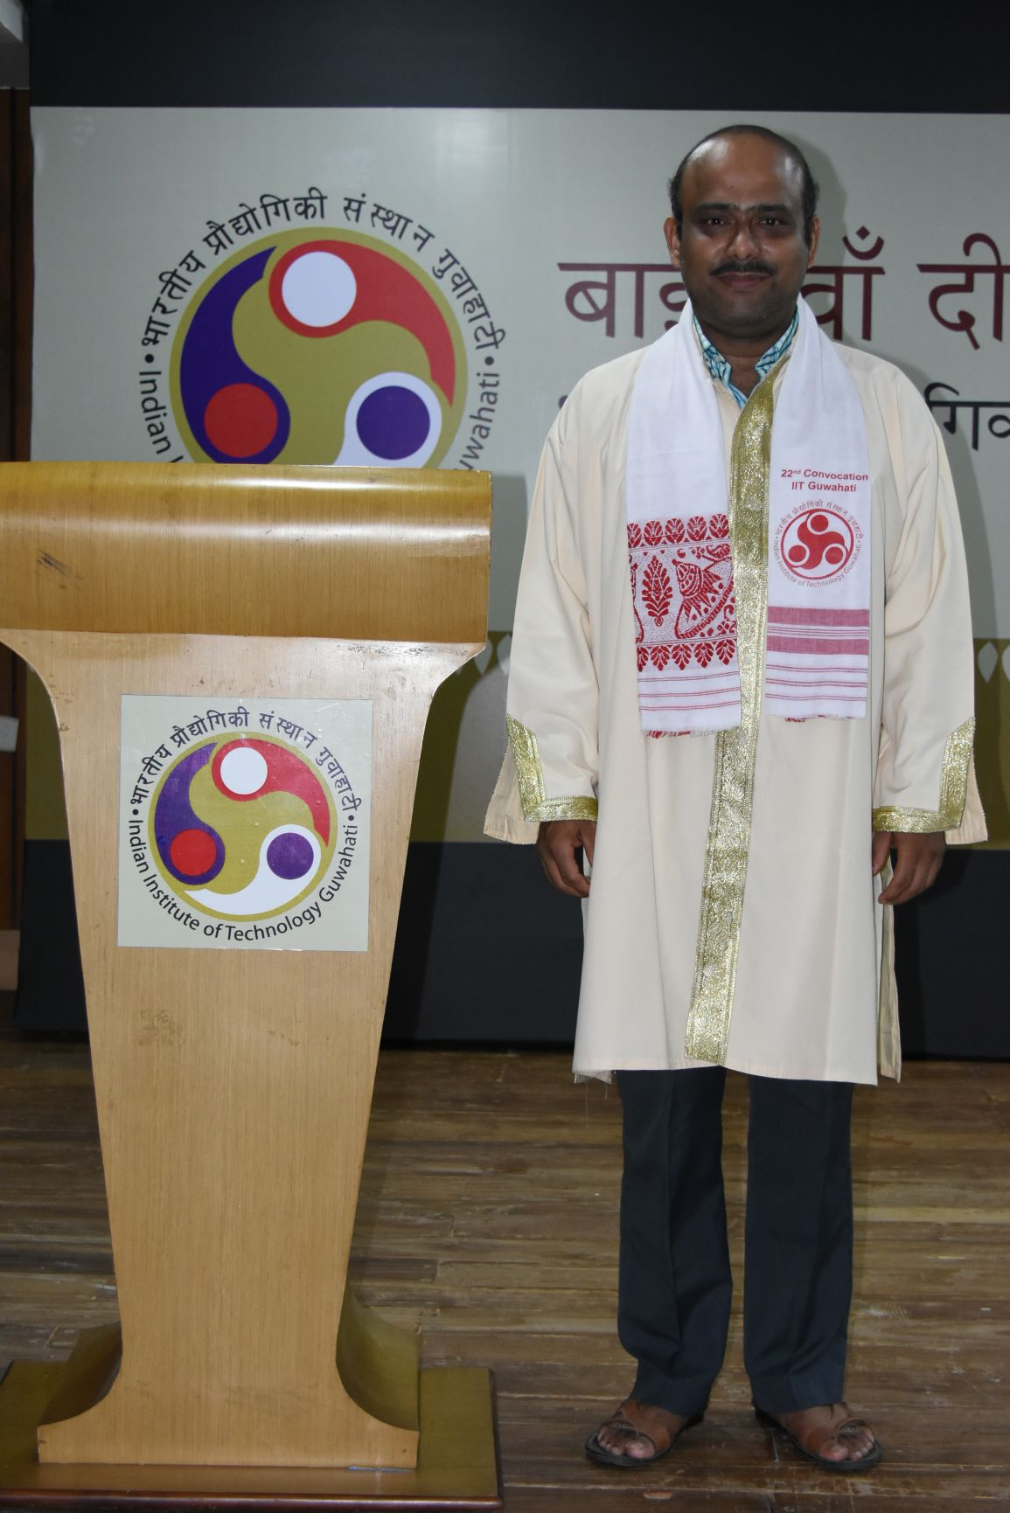
Head Of the Department
Prof. Gopal Das
B.Tech(Department of Chemistry)

Slide 2
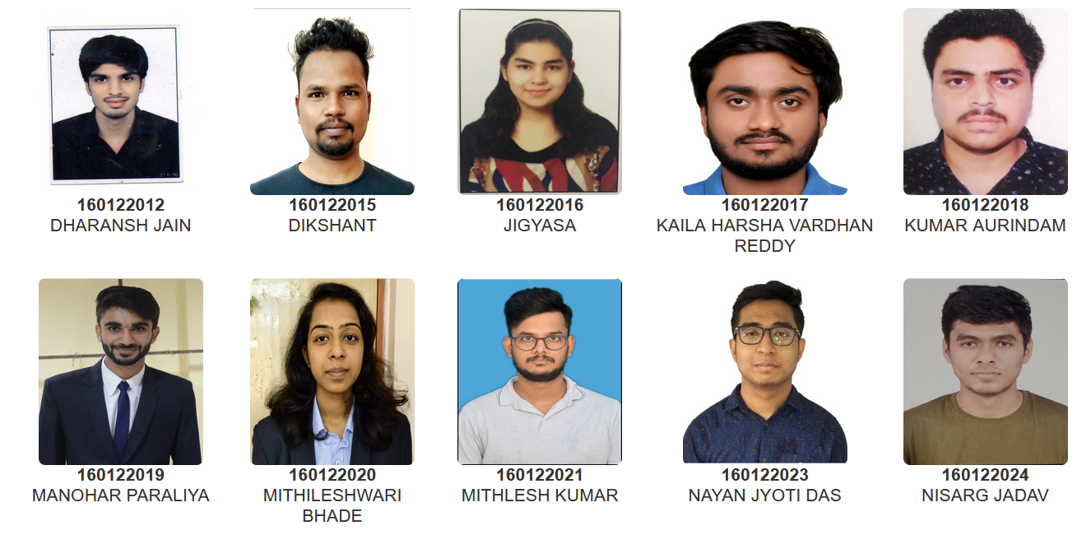
Head Of the Department
Prof. Gopal Das
B.Tech(Department of Chemistry)

Slide 3
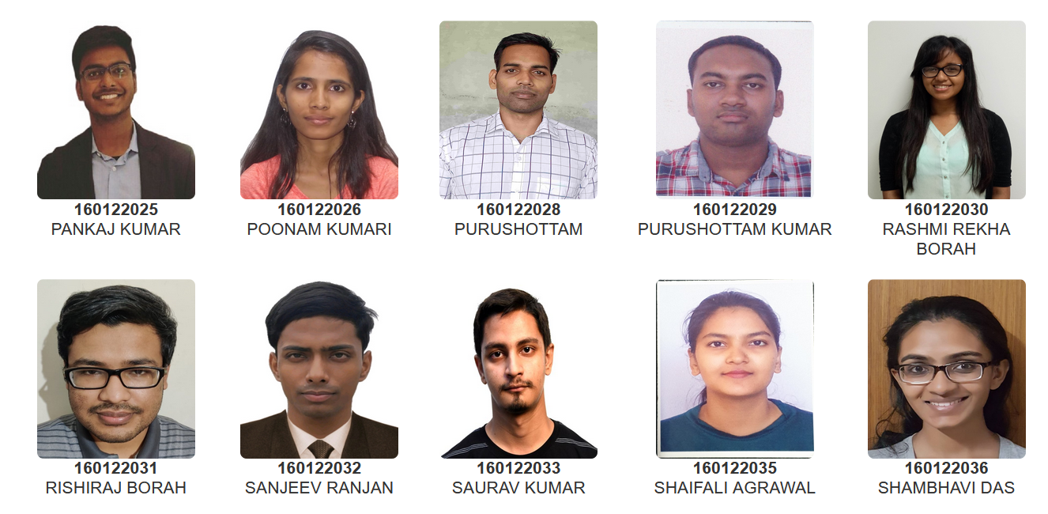
Head Of the Department
Prof. Gopal Das
B.Tech(Department of Chemistry)

Slide 4
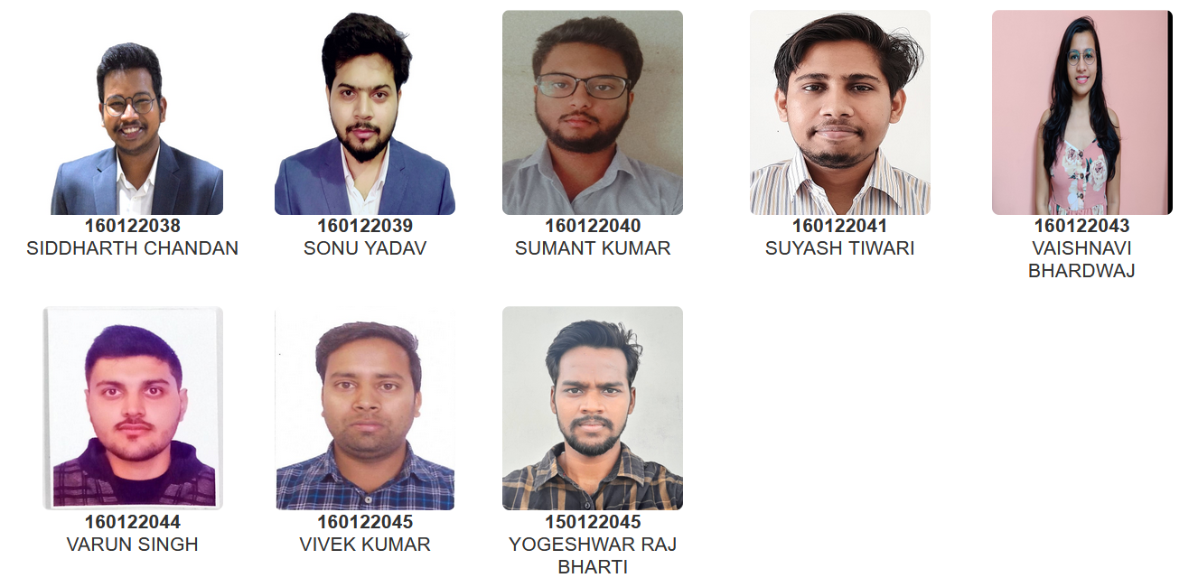
Head Of the Department
Prof. Gopal Das
B.Tech(Department of Chemistry)

