Slide 1
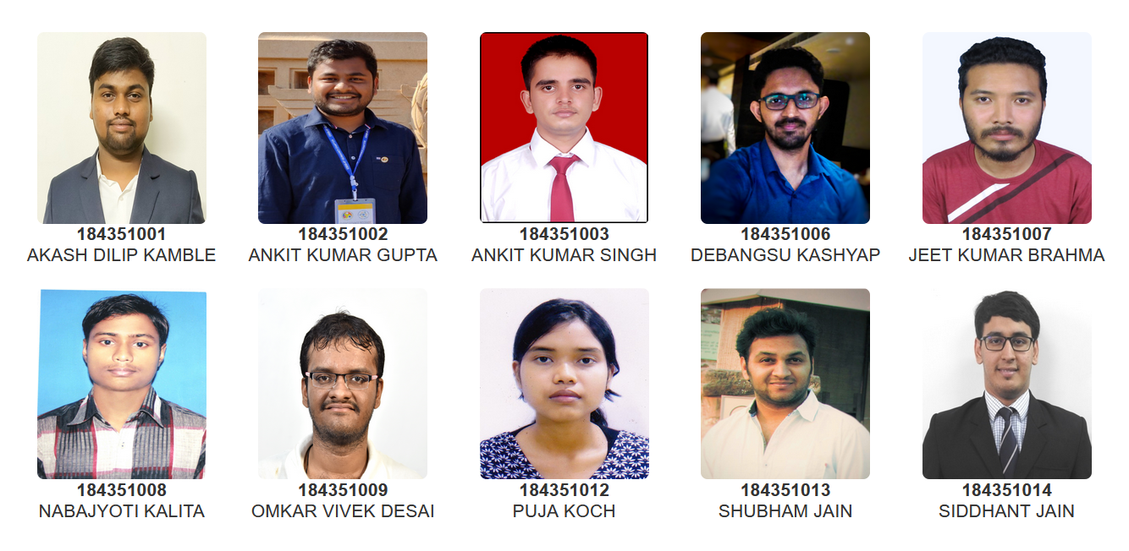
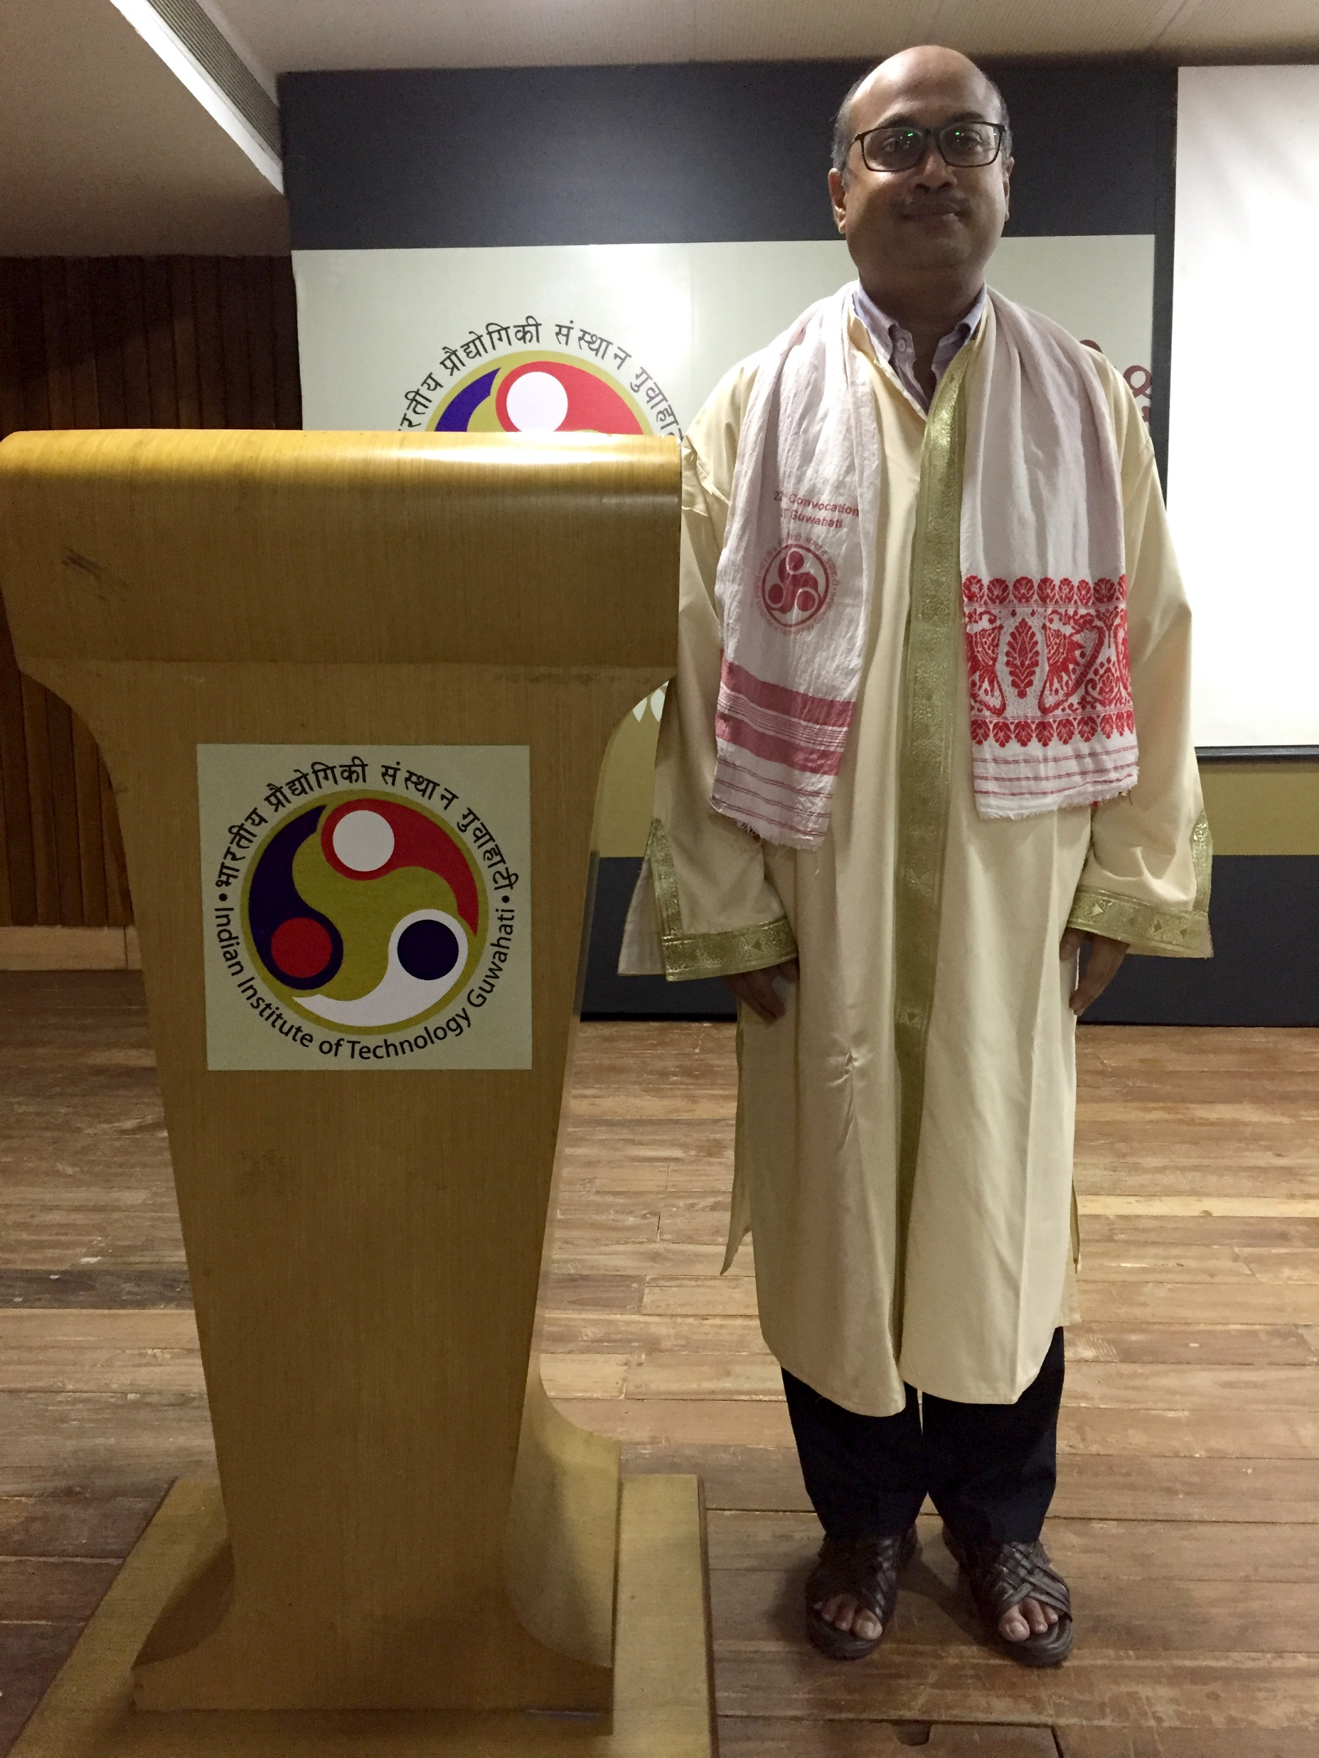
Head Of the Centre
Prof. Kaustubha Mohanty
MS-R(Centre for Energy)

Slide 2
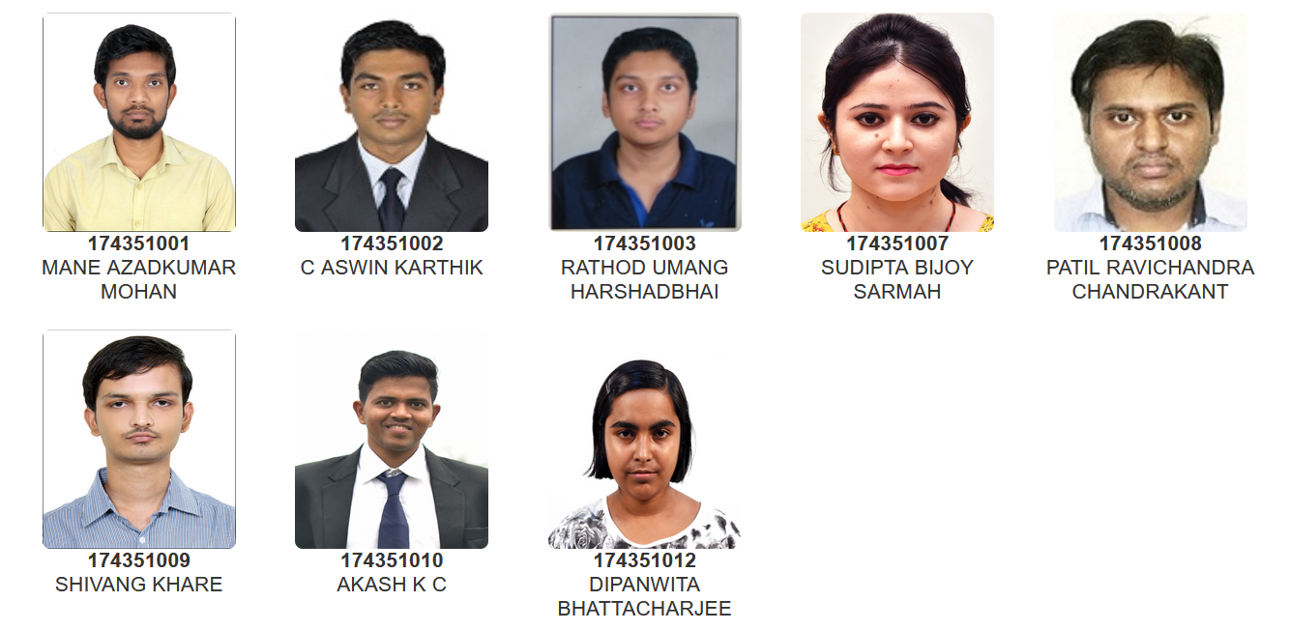
Head Of the Centre
Prof. Kaustubha Mohanty
MS-R(Centre for Energy)

