Slide 1
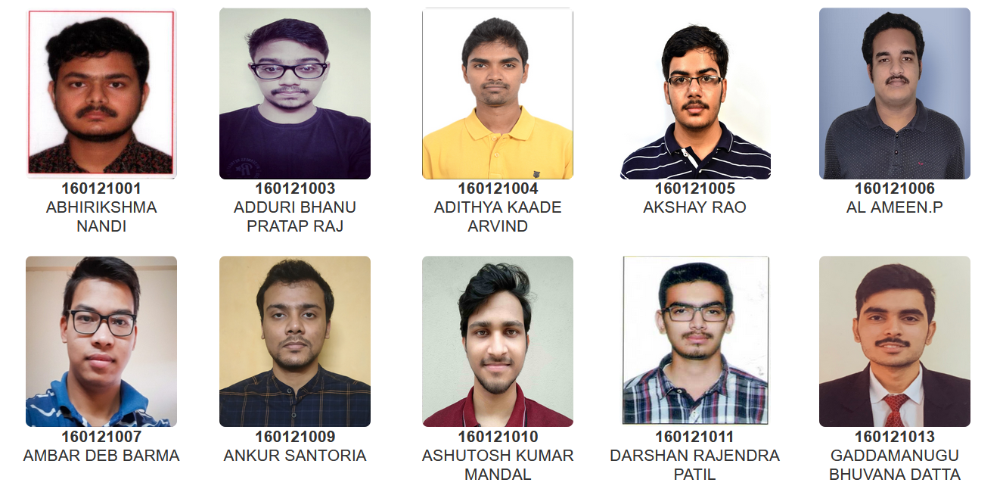
Head Of the Department
Prof. Subhradip Ghosh
B.Tech. (Department of Engineering Physics)

Slide 2
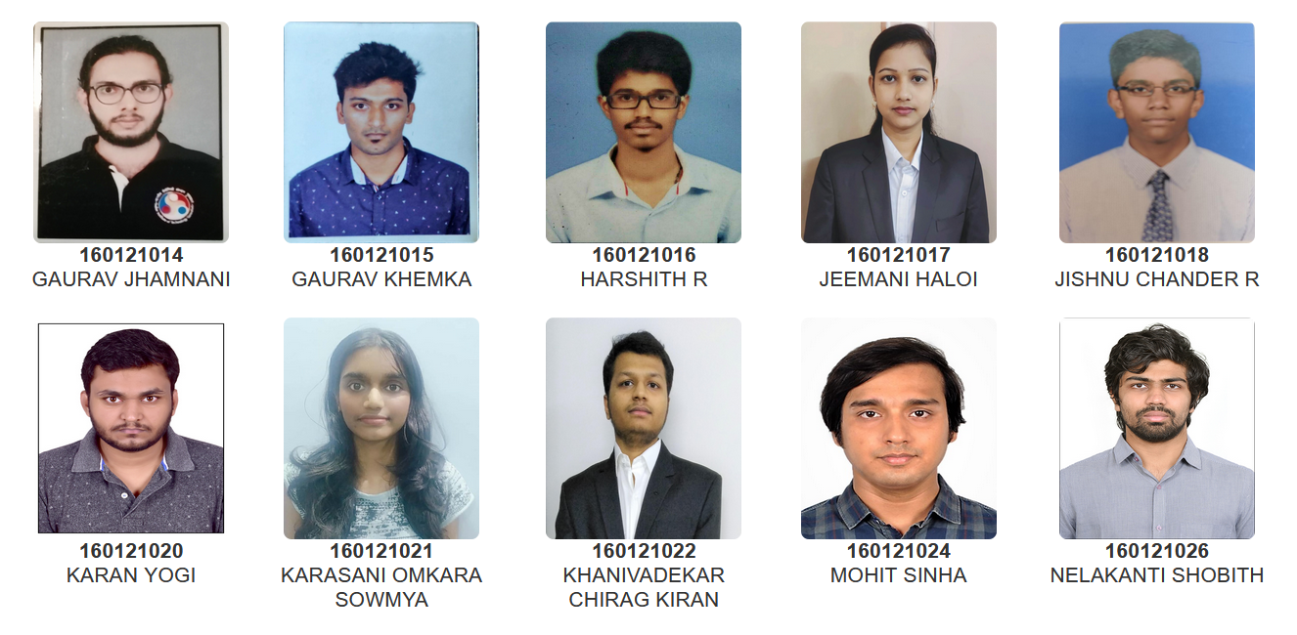
Head Of the Department
Prof. Subhradip Ghosh
B.Tech. (Department of Engineering Physics)

Slide 3
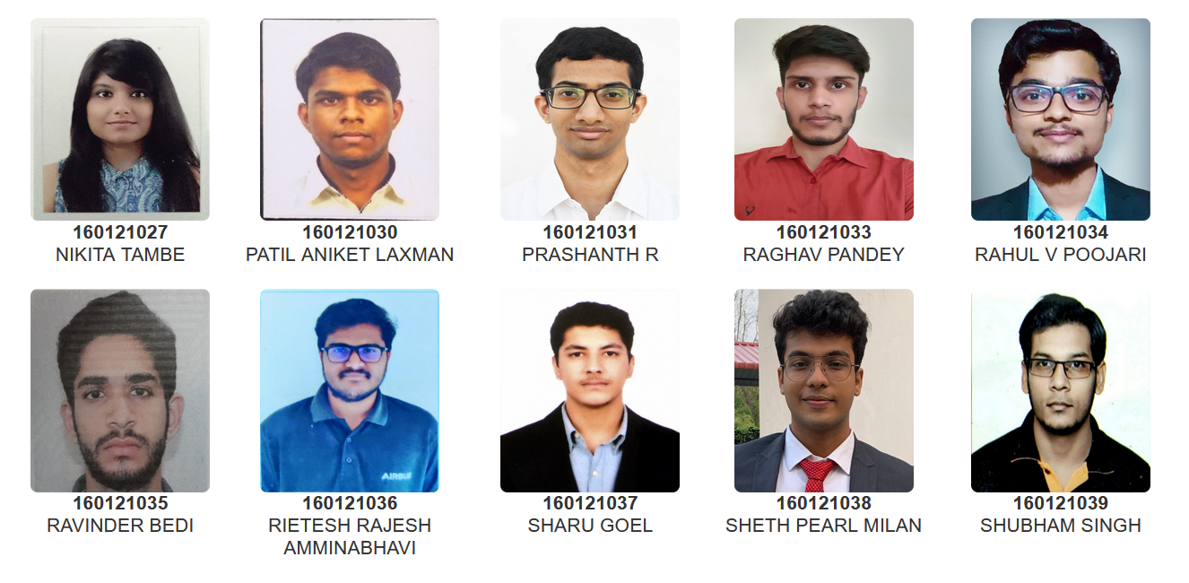
Head Of the Department
Prof. Subhradip Ghosh
B.Tech. (Department of Engineering Physics)

Slide 4
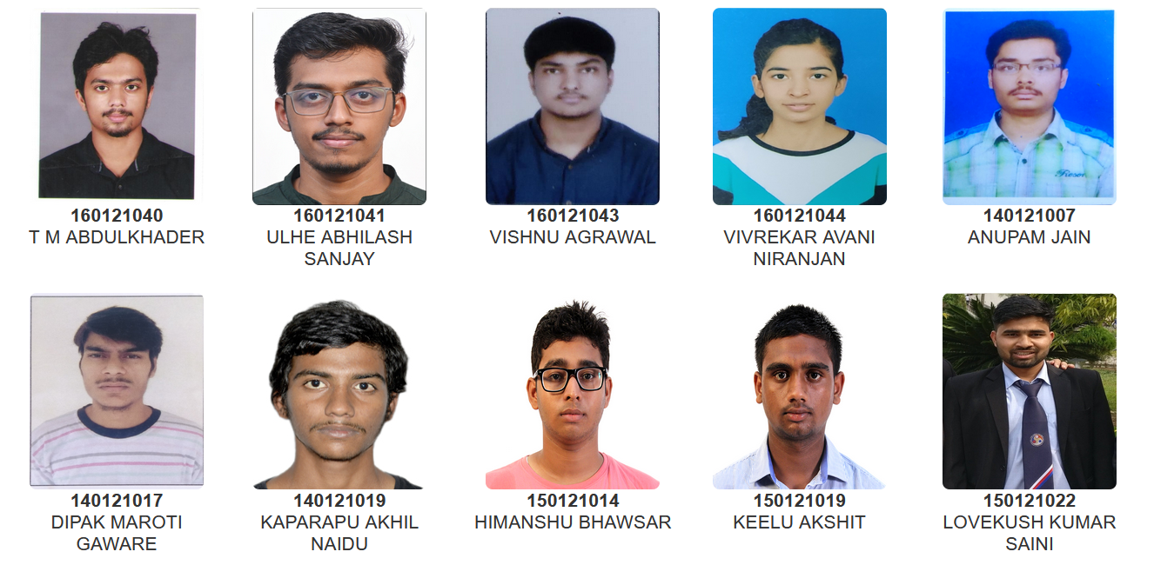
Head Of the Department
Prof. Subhradip Ghosh
B.Tech. (Department of Engineering Physics)

Slide 5
Head Of the Department
Prof. Subhradip Ghosh
B.Tech. (Department of Engineering Physics)

