Slide 1
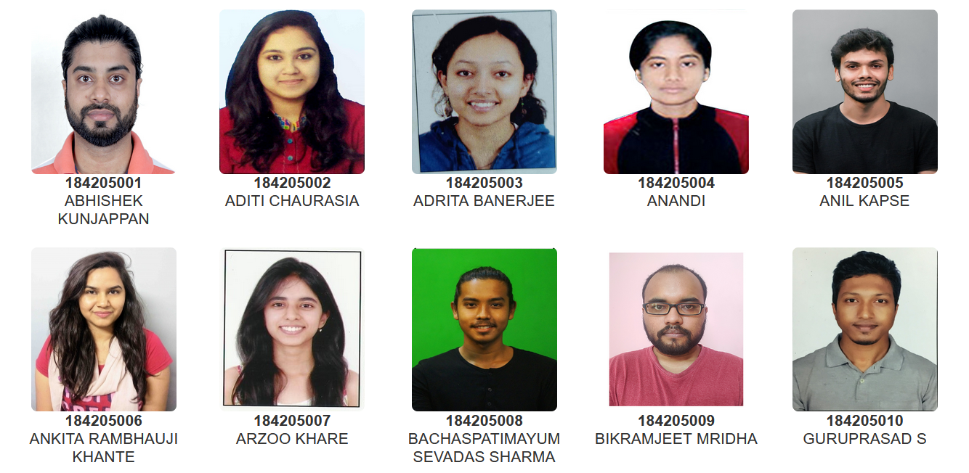
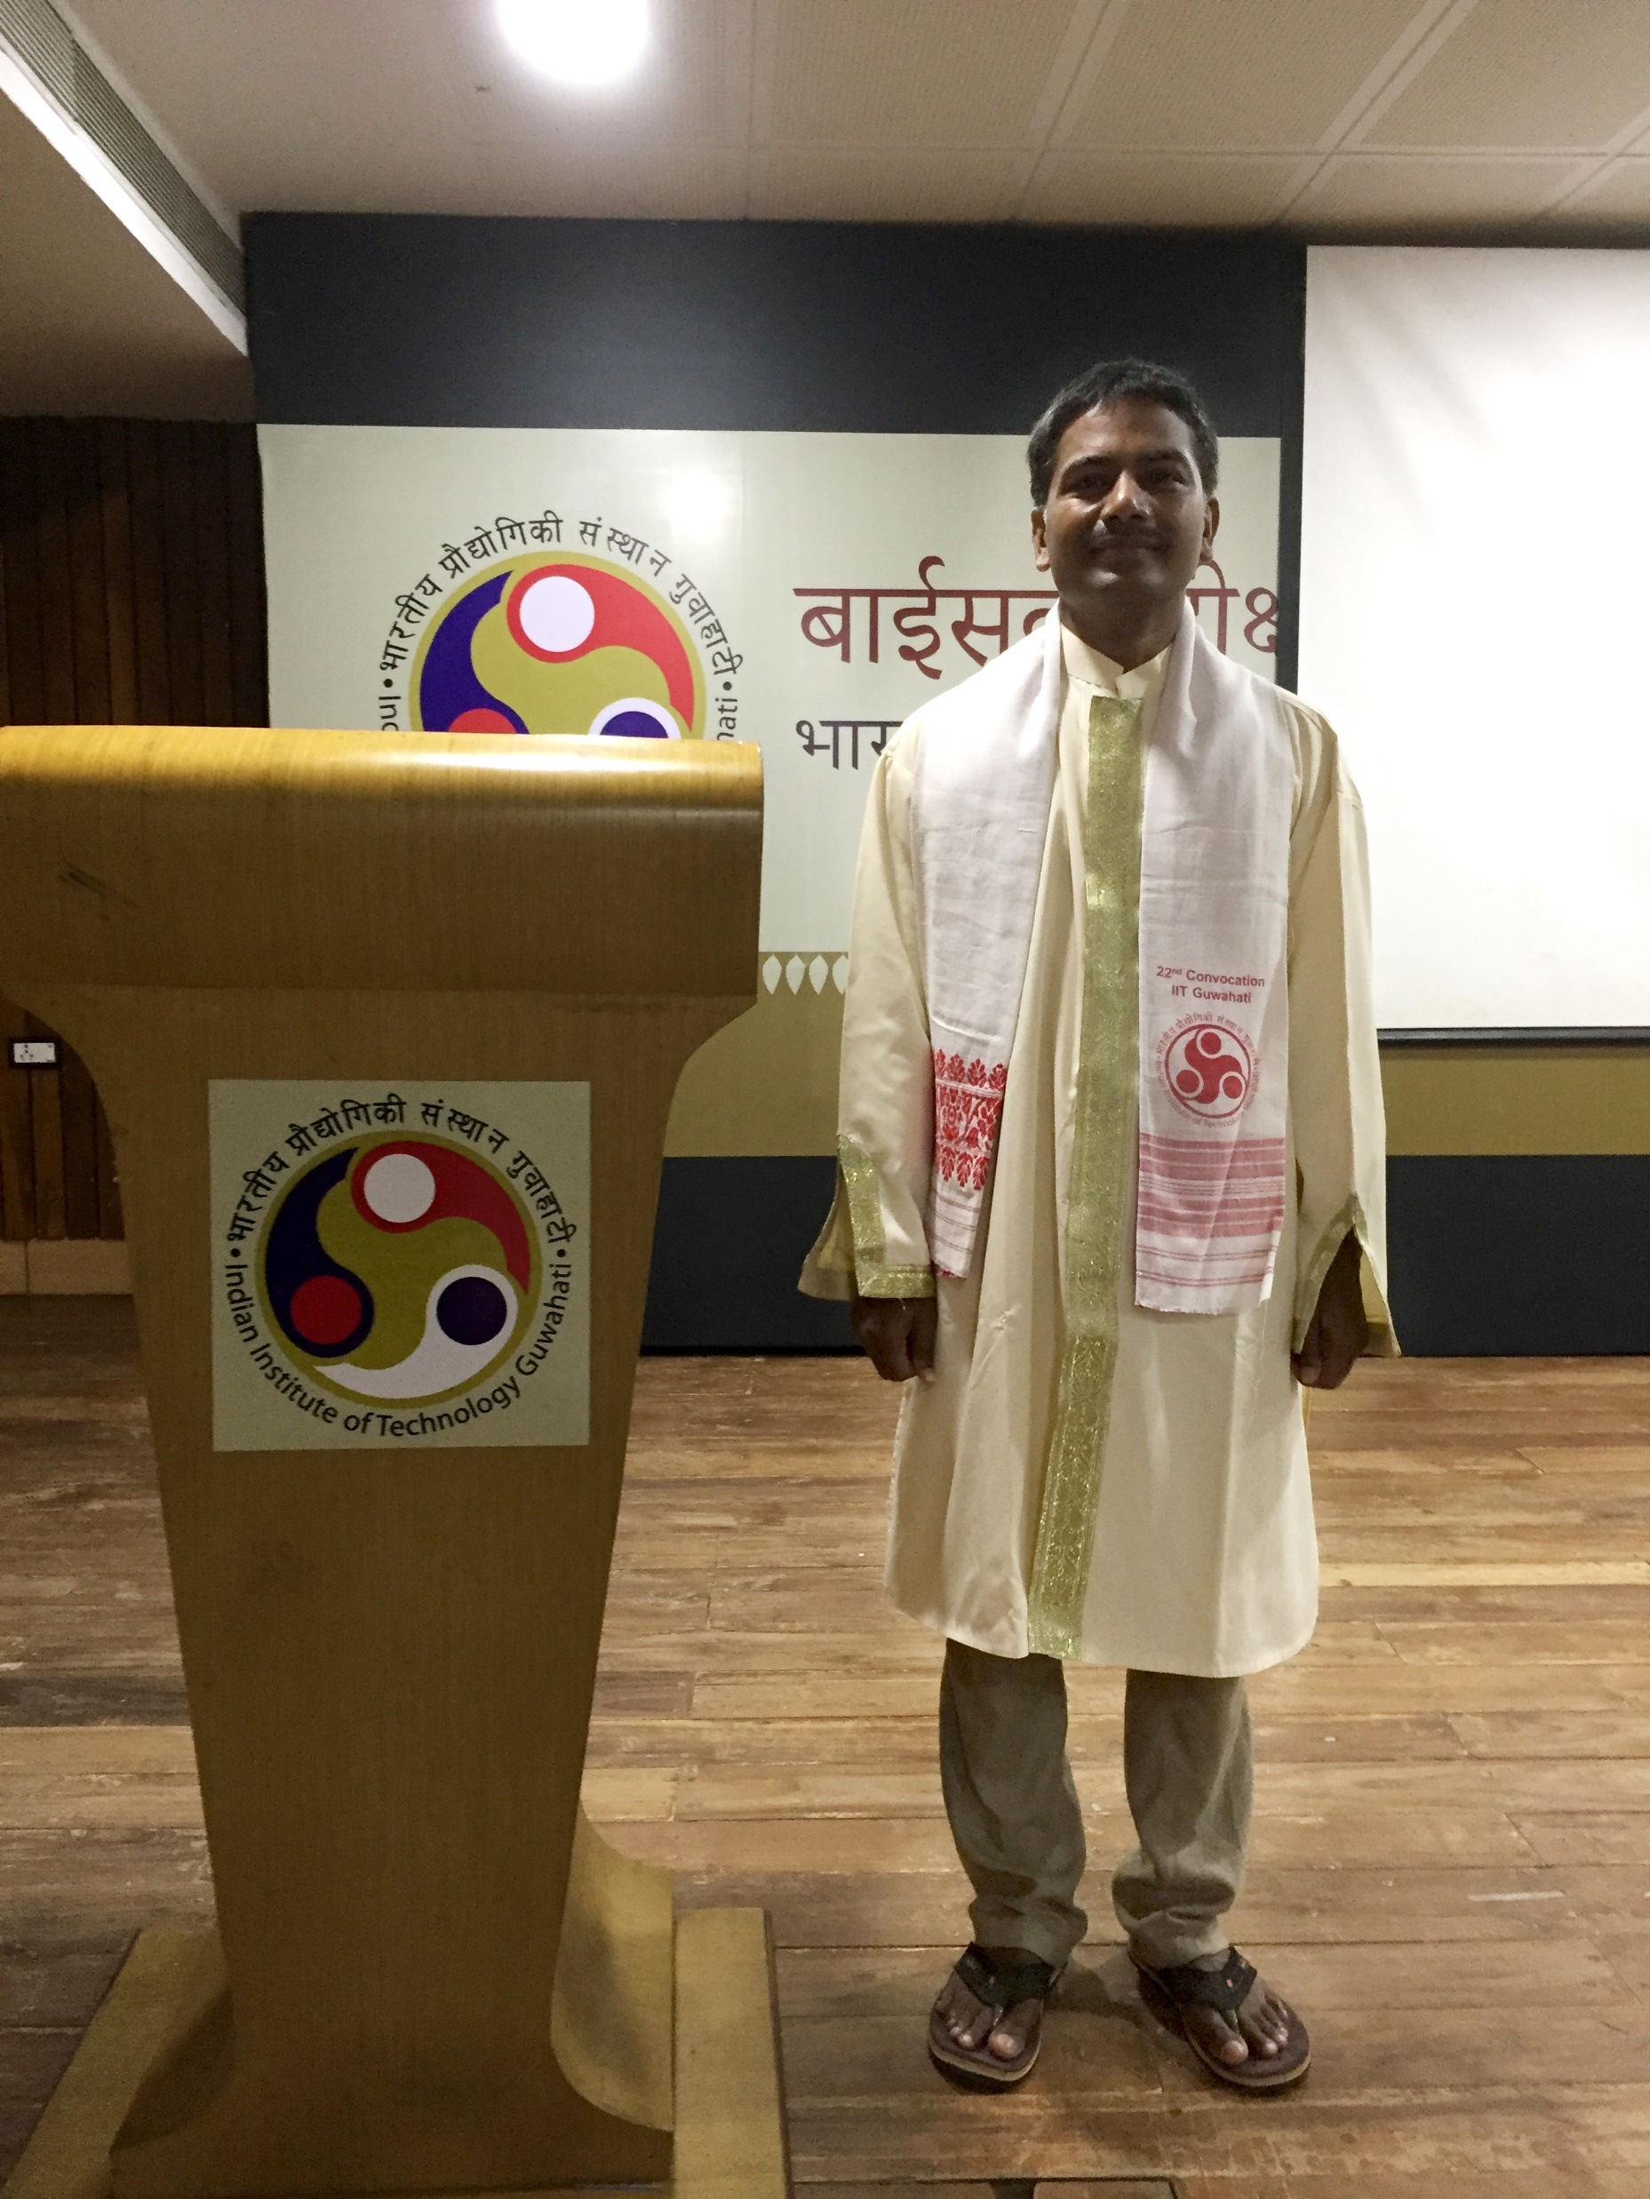
Head Of the Department
D. Udaya Kumar
Master of Design (Department of Design)

Slide 2
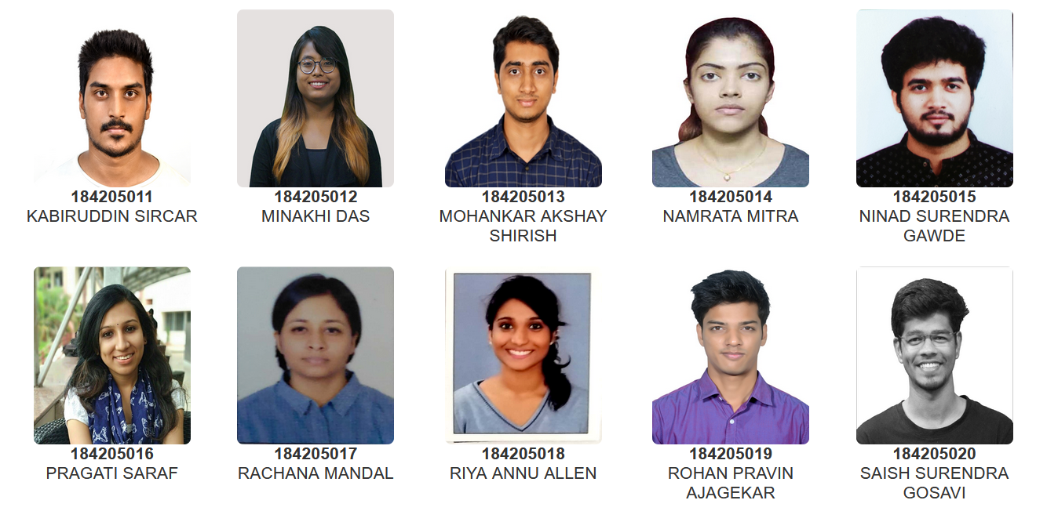
Head Of the Department
D. Udaya Kumar
Master of Design (Department of Design)

Slide 3
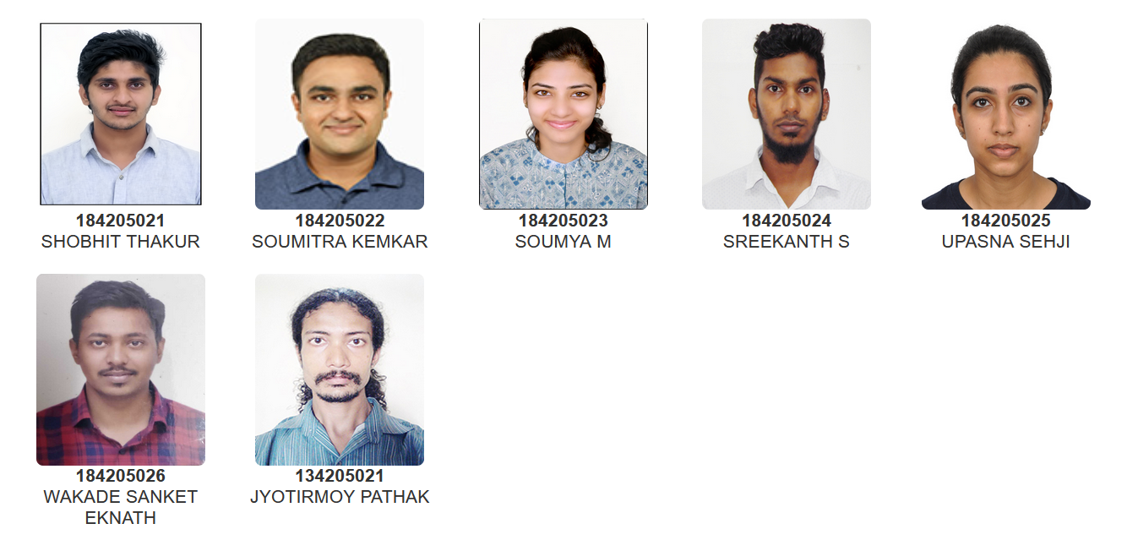
Head Of the Department
D. Udaya Kumar
Master of Design (Department of Design)

