Slide 1
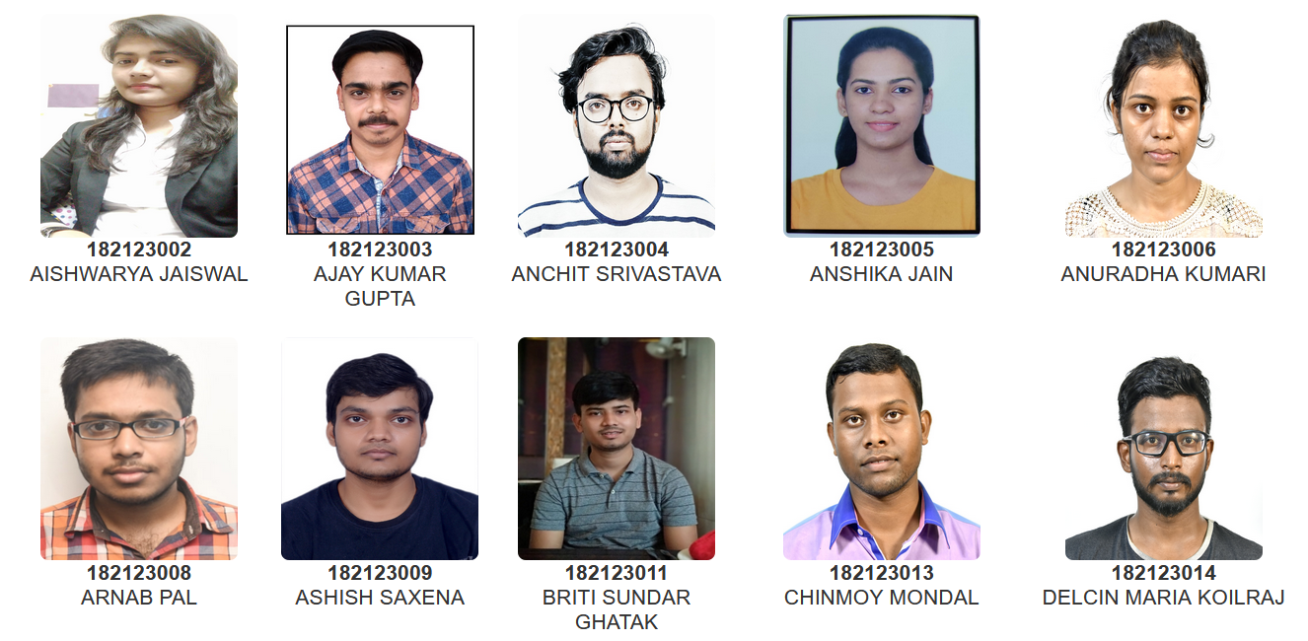
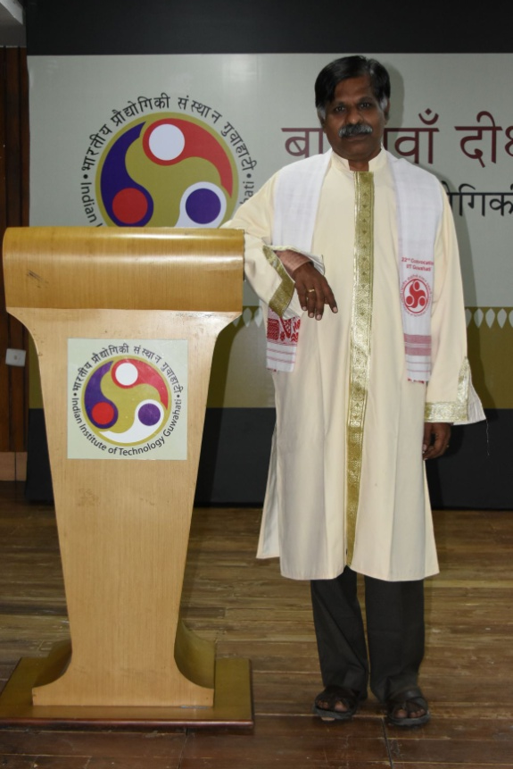
Head Of the Department
Prof. M. Guru Prem Prasad
B.Tech. (Department of Mathematics)

Slide 2
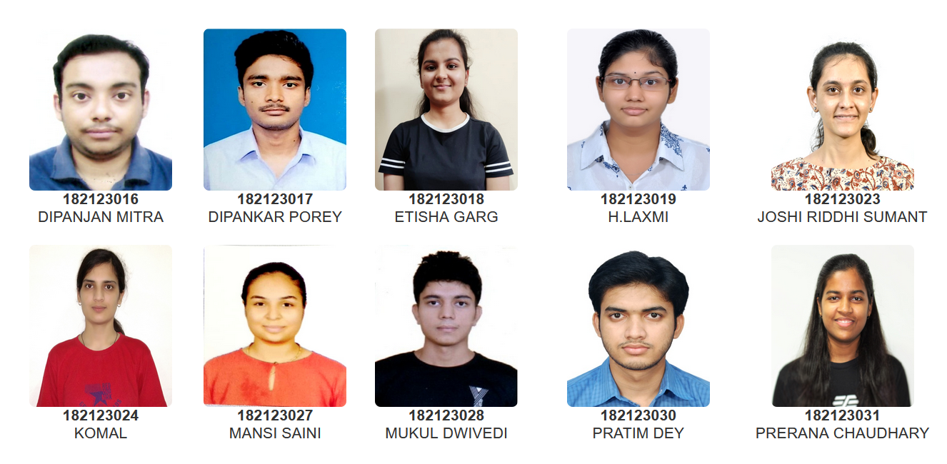
Head Of the Department
Prof. M. Guru Prem Prasad
B.Tech. (Department of Mathematics)

Slide 3
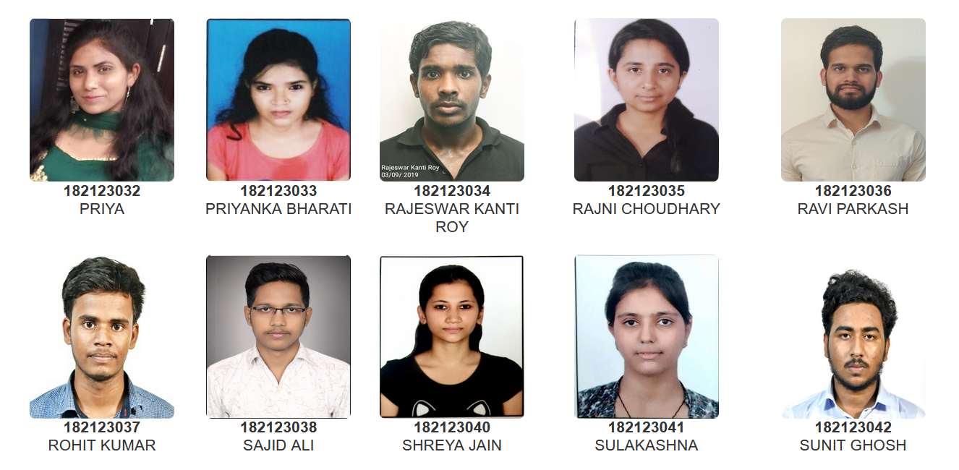
Head Of the Department
Prof. M. Guru Prem Prasad
B.Tech. (Department of Mathematics)

Slide 4
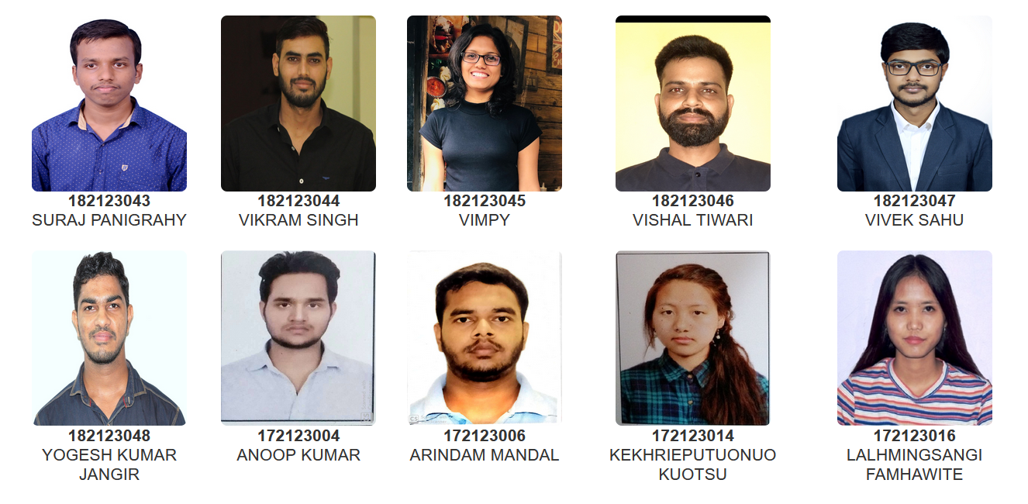
Head Of the Department
Prof. M. Guru Prem Prasad
B.Tech. (Department of Mathematics)

Slide 5
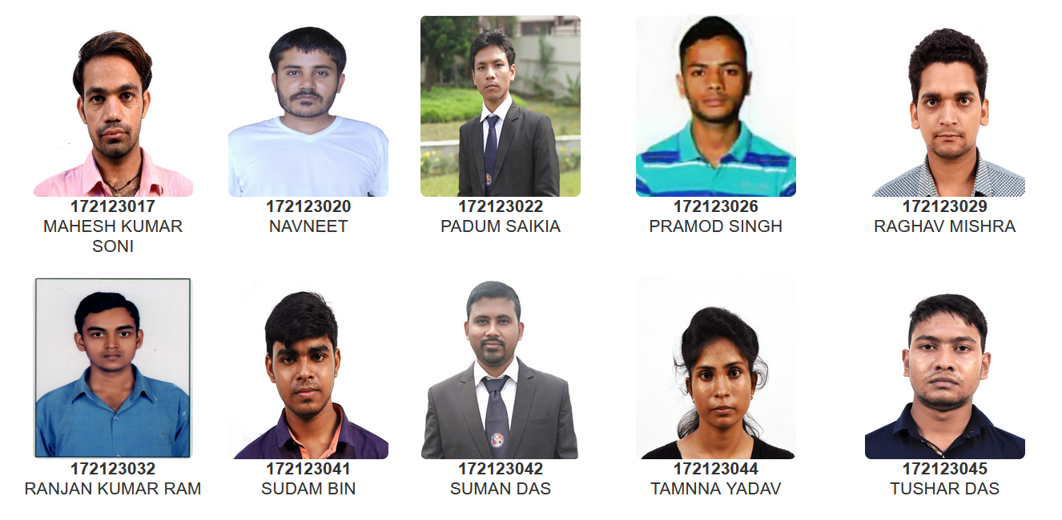
Head Of the Department
Prof. M. Guru Prem Prasad
B.Tech. (Department of Mathematics)

Slide 6
Head Of the Department
Prof. M. Guru Prem Prasad
B.Tech. (Department of Mathematics)

