Slide 1
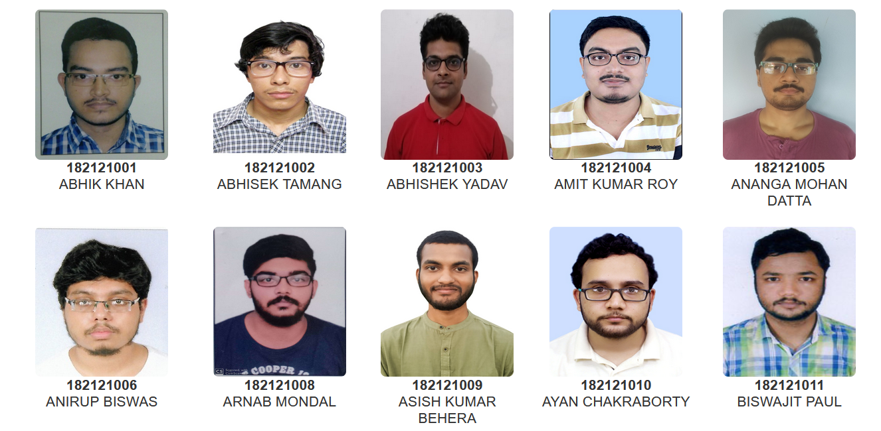
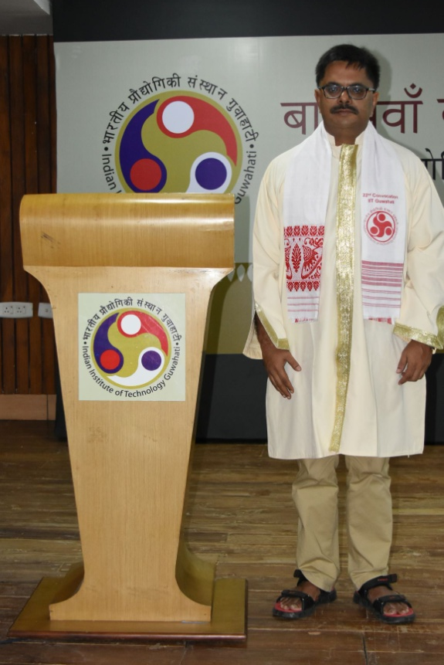
Head Of the Department
Prof. Subhradip Ghosh
M.Sc. (Department of Physics)

Slide 2
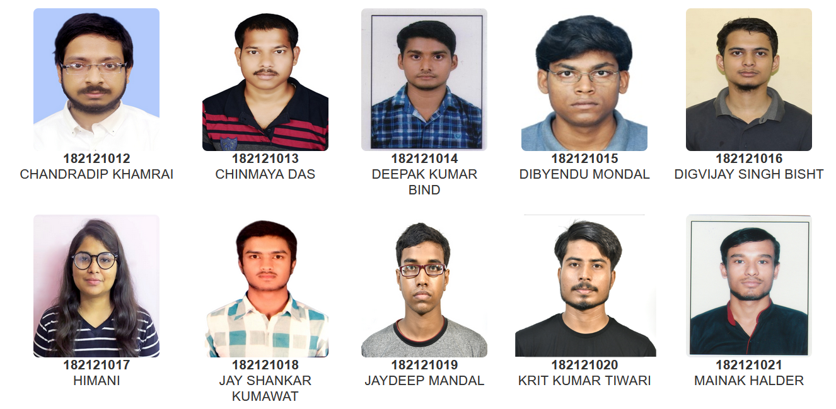
Head Of the Department
Prof. Subhradip Ghosh
M.Sc. (Department of Physics)

Slide 3
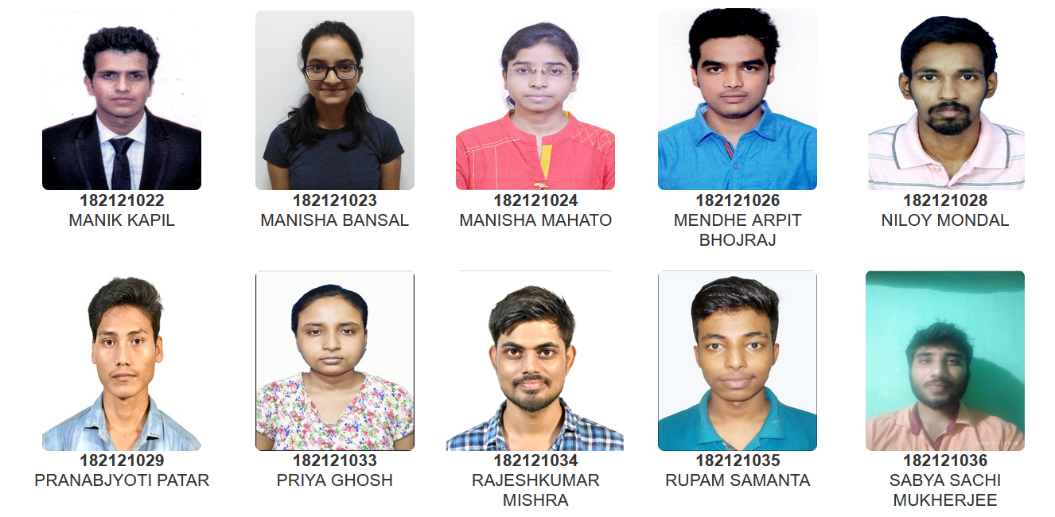
Head Of the Department
Prof. Subhradip Ghosh
M.Sc. (Department of Physics)

Slide 4
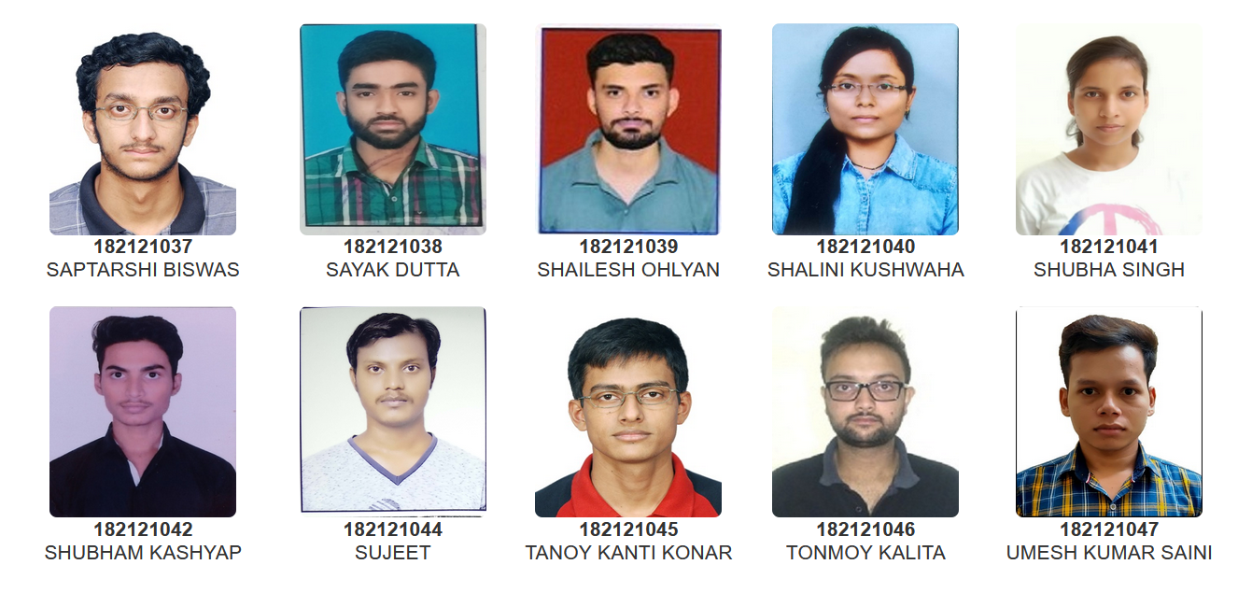
Head Of the Department
Prof. Subhradip Ghosh
M.Sc. (Department of Physics)

Slide 5
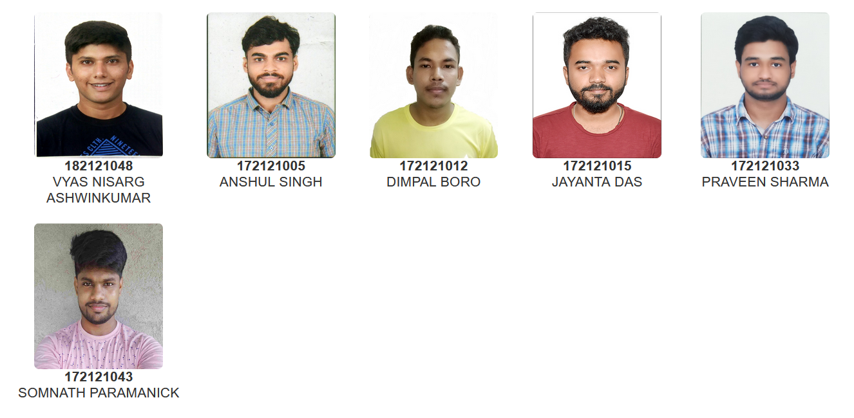
Head Of the Department
Prof. Subhradip Ghosh
M.Sc. (Department of Physics)

