Slide 1
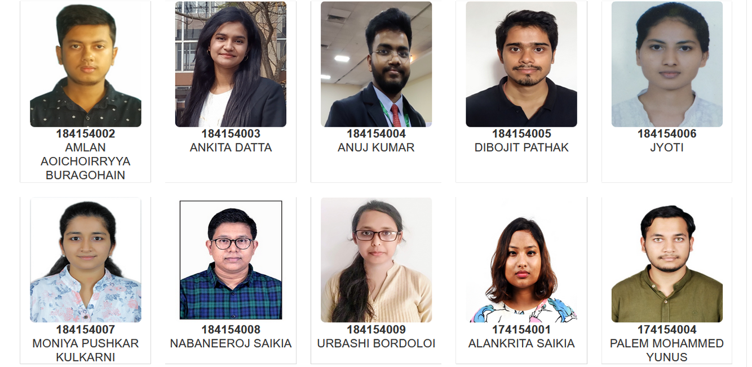
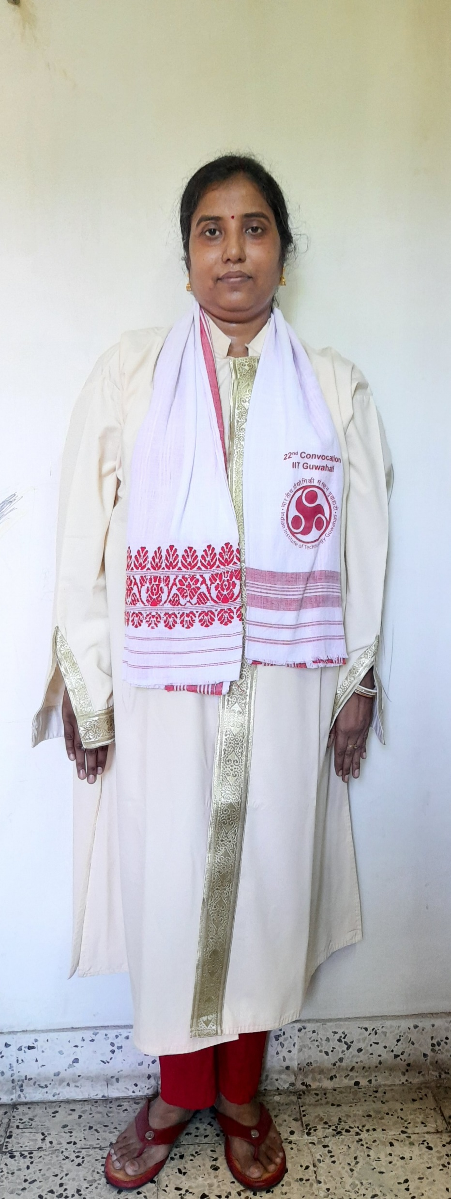
Head Of the Centre
Prof. Sanjukta Patra
M.Tech(Centre for Rural Technology)

Slide 2
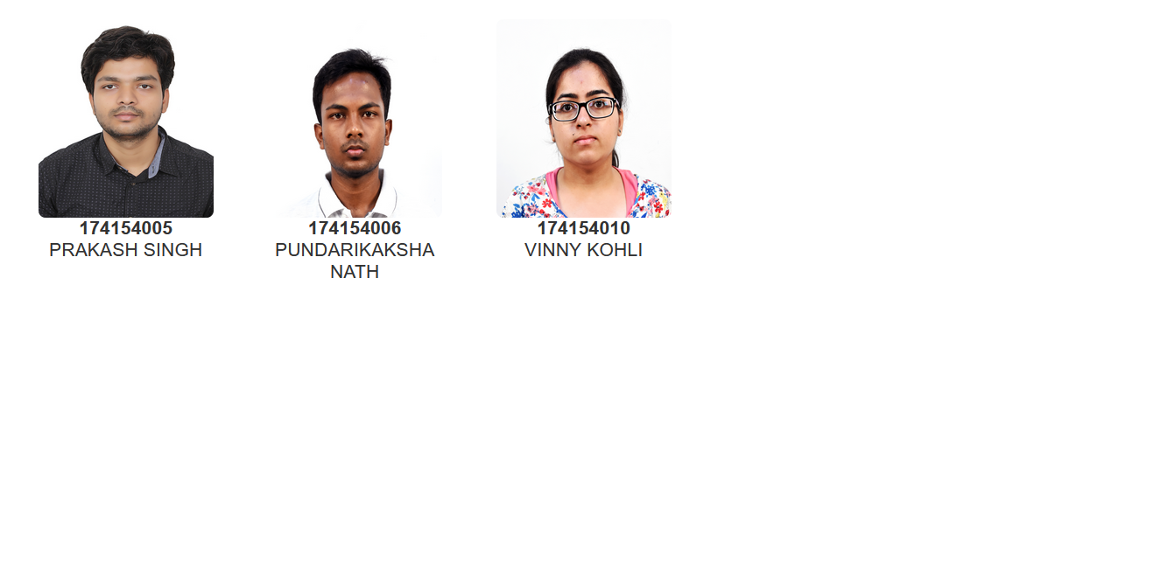
Head Of the Centre
Prof. Sanjukta Patra
M.Tech(Centre for Rural Technology)

