Slide 1
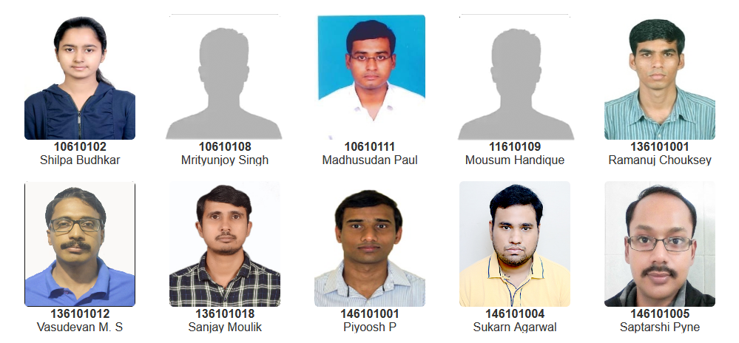
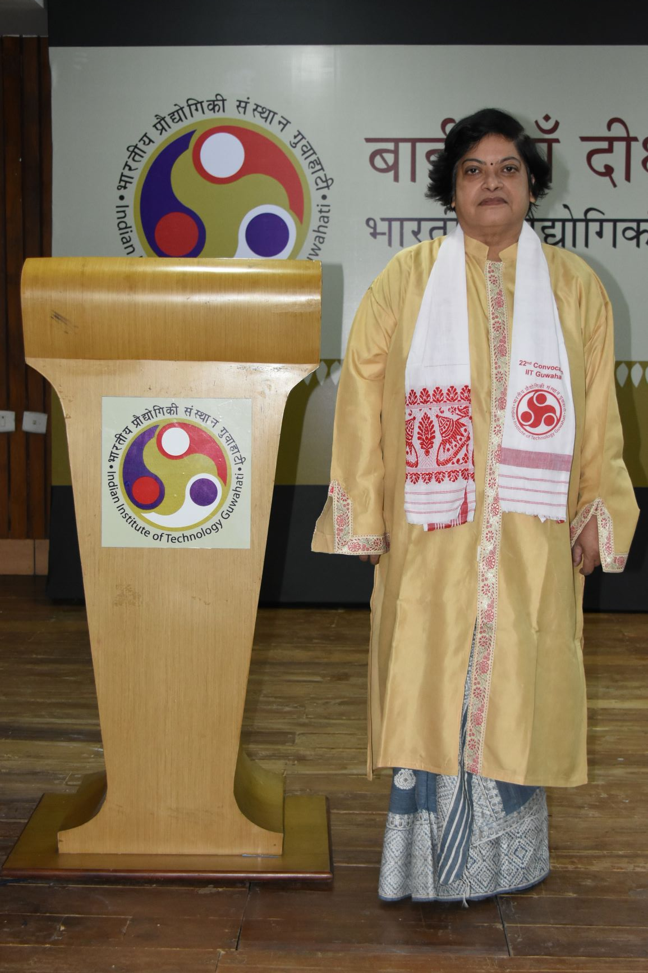
Dean of Academic Affairs
Prof. Chitralekha Mahanta
Doctor of Philosophy

Slide 2
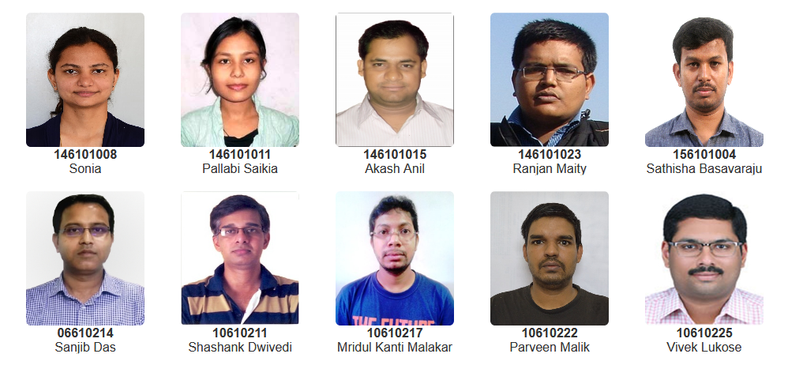
Dean of Academic Affairs
Prof. Chitralekha Mahanta
Doctor of Philosophy

Slide 3
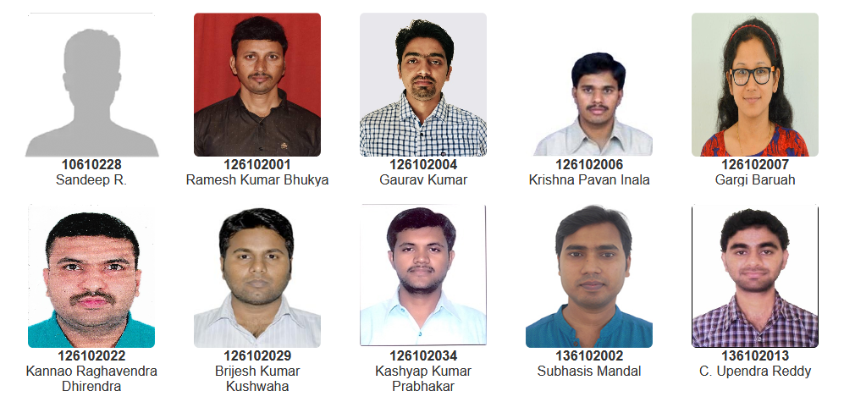
Dean of Academic Affairs
Prof. Chitralekha Mahanta
Doctor of Philosophy

Slide 4
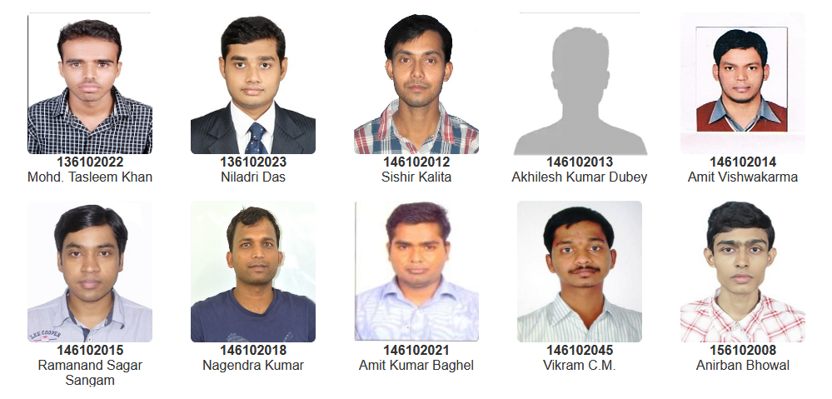
Dean of Academic Affairs
Prof. Chitralekha Mahanta
Doctor of Philosophy

Slide 5
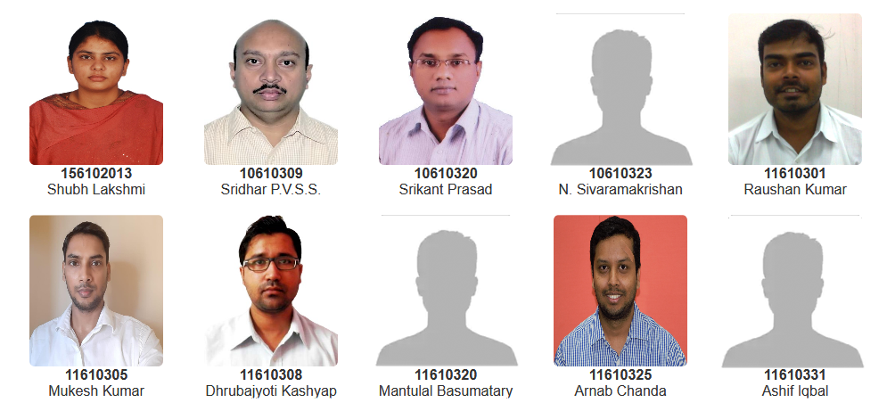
Dean of Academic Affairs
Prof. Chitralekha Mahanta
Doctor of Philosophy

Slide 6
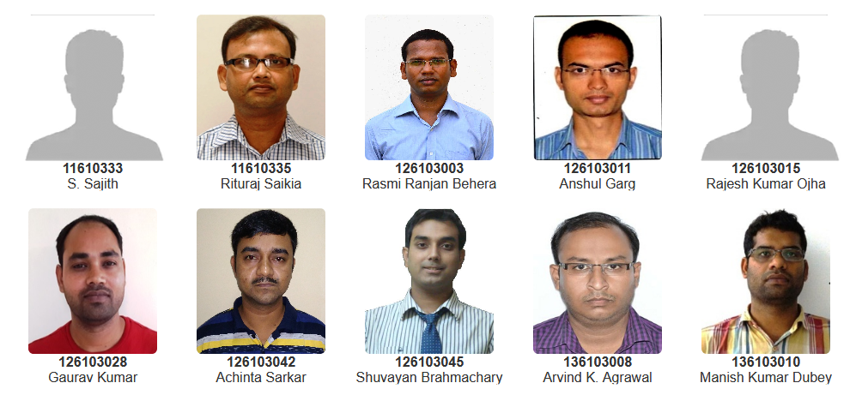
Dean of Academic Affairs
Prof. Chitralekha Mahanta
Doctor of Philosophy

Slide 7
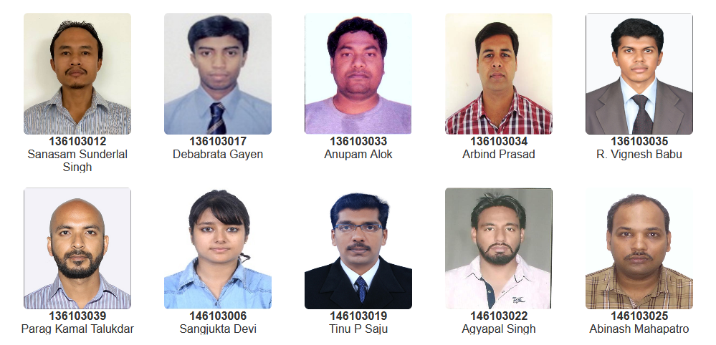
Dean of Academic Affairs
Prof. Chitralekha Mahanta
Doctor of Philosophy

Slide 8
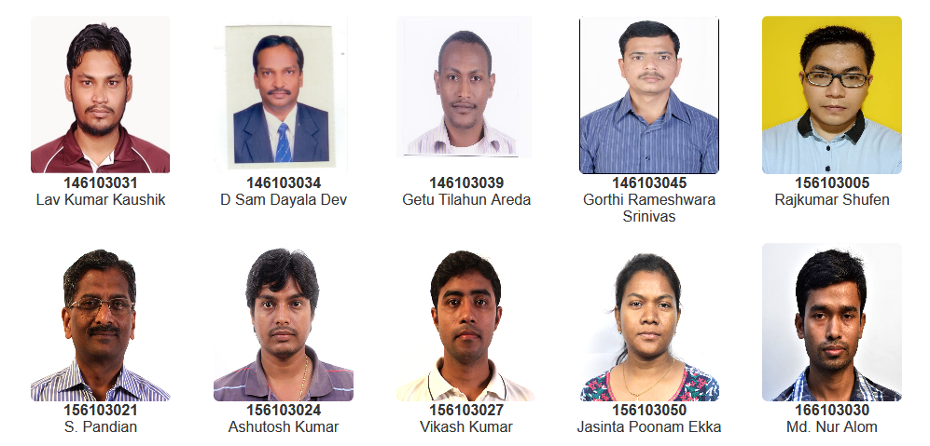
Dean of Academic Affairs
Prof. Chitralekha Mahanta
Doctor of Philosophy

Slide 9
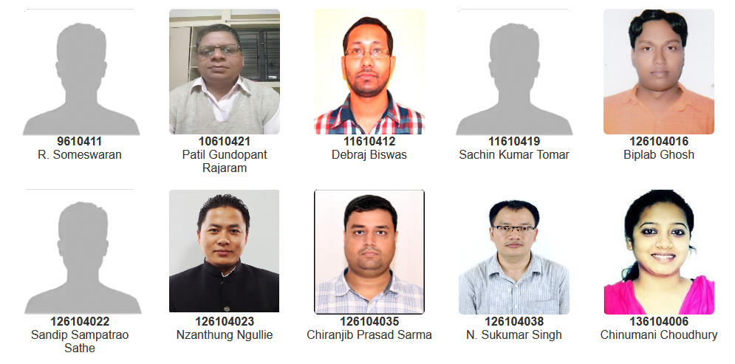
Dean of Academic Affairs
Prof. Chitralekha Mahanta
Doctor of Philosophy

Slide 10
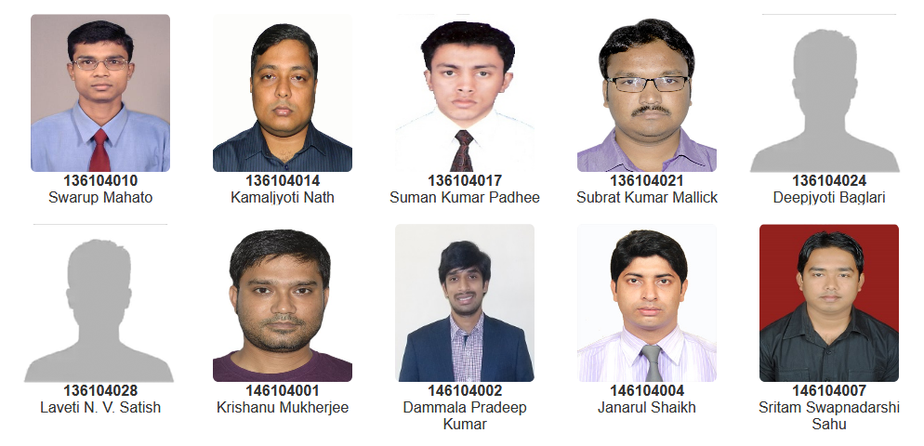
Dean of Academic Affairs
Prof. Chitralekha Mahanta
Doctor of Philosophy

Slide 11
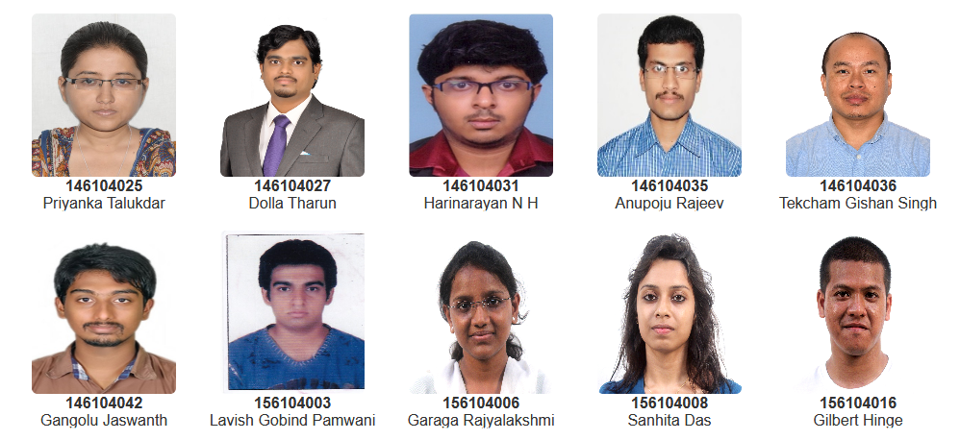
Dean of Academic Affairs
Prof. Chitralekha Mahanta
Doctor of Philosophy

Slide 12
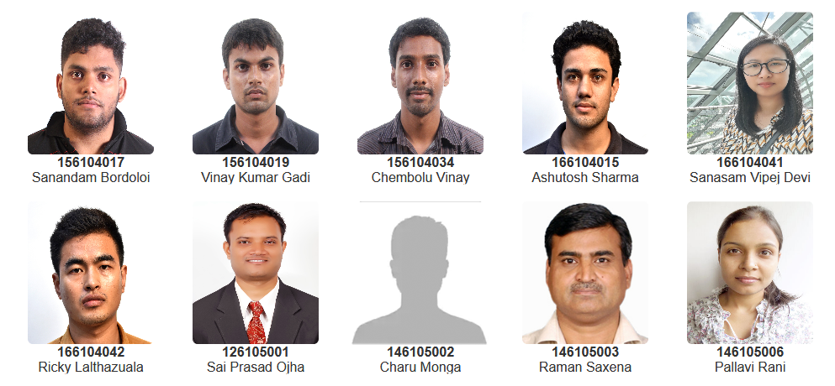
Dean of Academic Affairs
Prof. Chitralekha Mahanta
Doctor of Philosophy

Slide 13
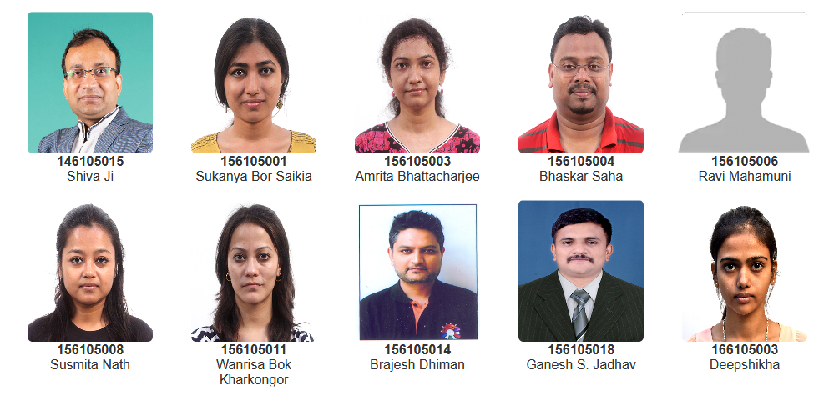
Dean of Academic Affairs
Prof. Chitralekha Mahanta
Doctor of Philosophy

Slide 14
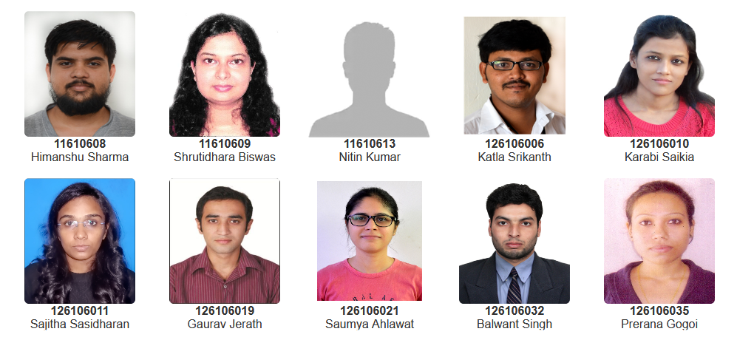
Dean of Academic Affairs
Prof. Chitralekha Mahanta
Doctor of Philosophy

Slide 15
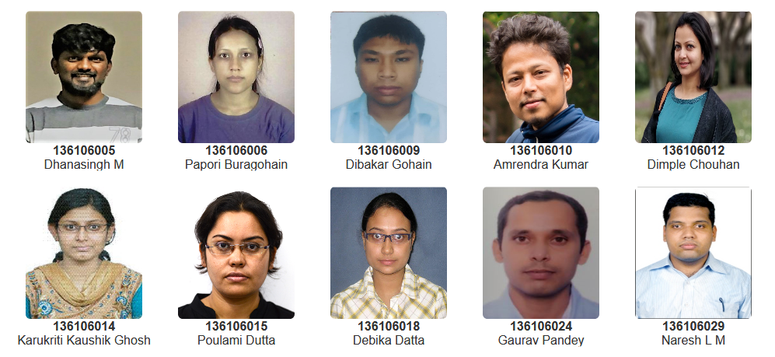
Dean of Academic Affairs
Prof. Chitralekha Mahanta
Doctor of Philosophy

Slide 16
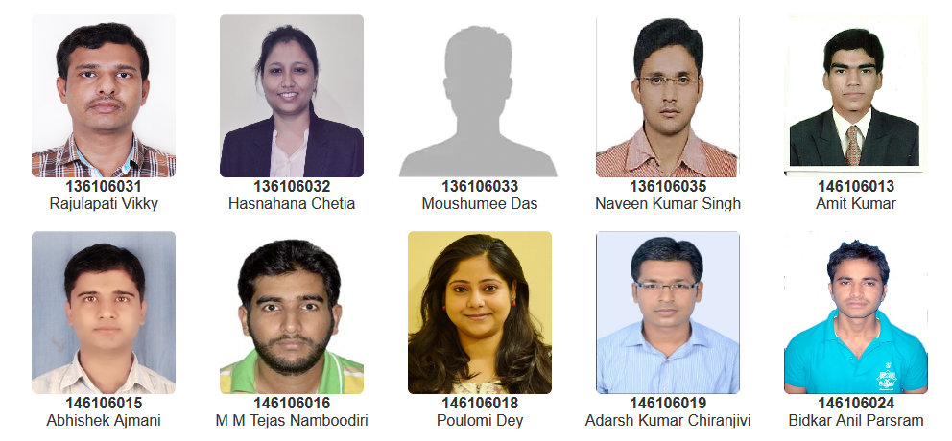
Dean of Academic Affairs
Prof. Chitralekha Mahanta
Doctor of Philosophy

Slide 17
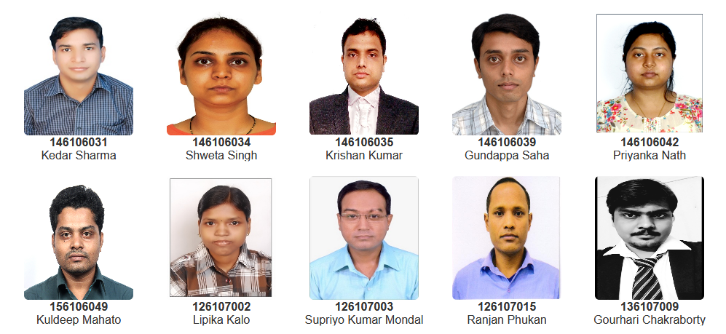
Dean of Academic Affairs
Prof. Chitralekha Mahanta
Doctor of Philosophy

Slide 18
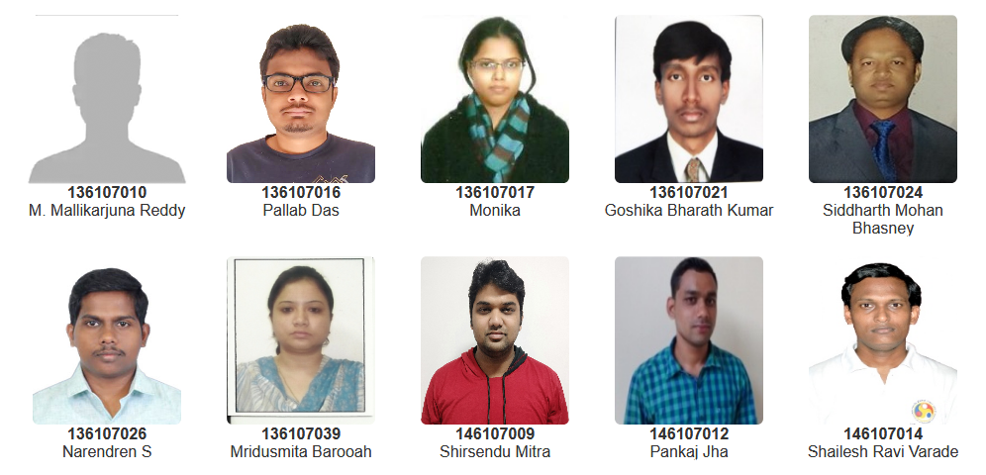
Dean of Academic Affairs
Prof. Chitralekha Mahanta
Doctor of Philosophy

Slide 19
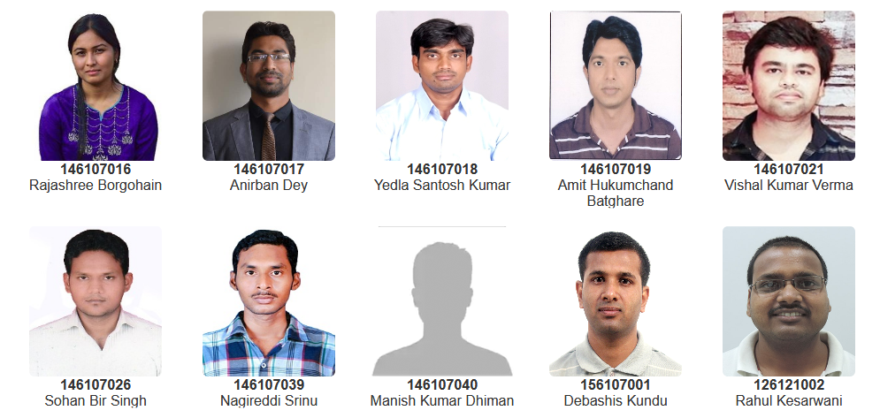
Dean of Academic Affairs
Prof. Chitralekha Mahanta
Doctor of Philosophy

Slide 20
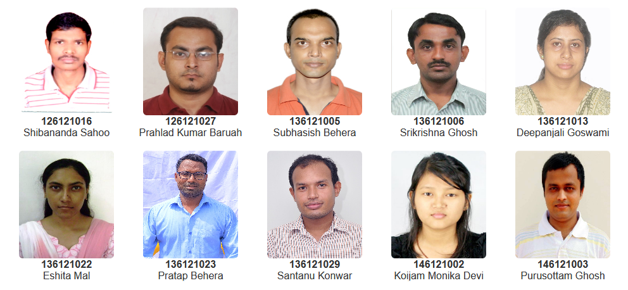
Dean of Academic Affairs
Prof. Chitralekha Mahanta
Doctor of Philosophy

Slide 21
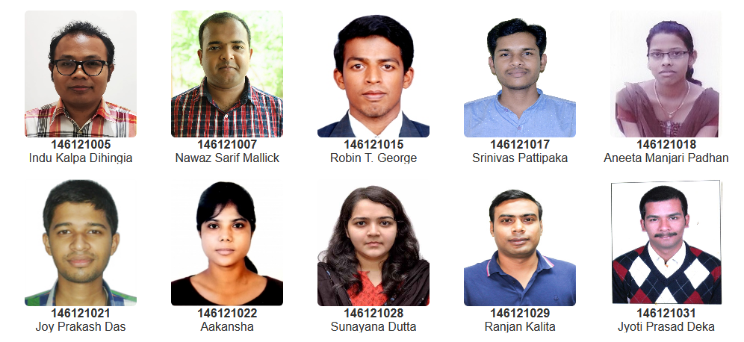
Dean of Academic Affairs
Prof. Chitralekha Mahanta
Doctor of Philosophy

Slide 22
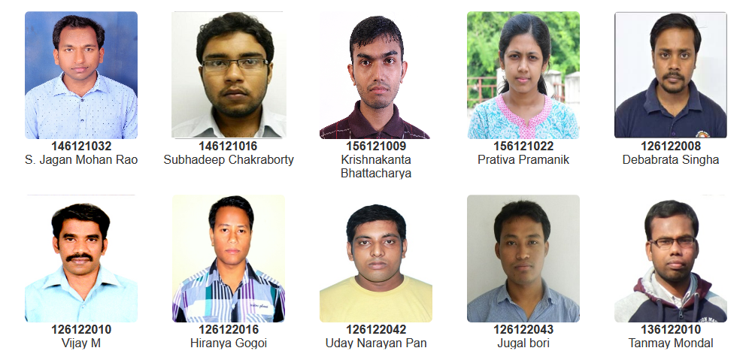
Dean of Academic Affairs
Prof. Chitralekha Mahanta
Doctor of Philosophy

Slide 23
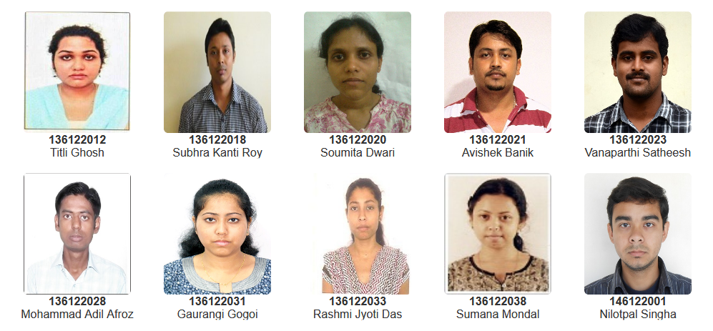
Dean of Academic Affairs
Prof. Chitralekha Mahanta
Doctor of Philosophy

Slide 24
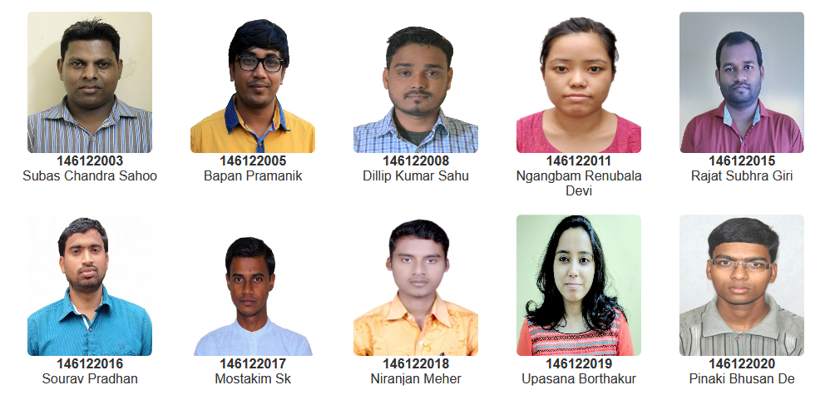
Dean of Academic Affairs
Prof. Chitralekha Mahanta
Doctor of Philosophy

Slide 25
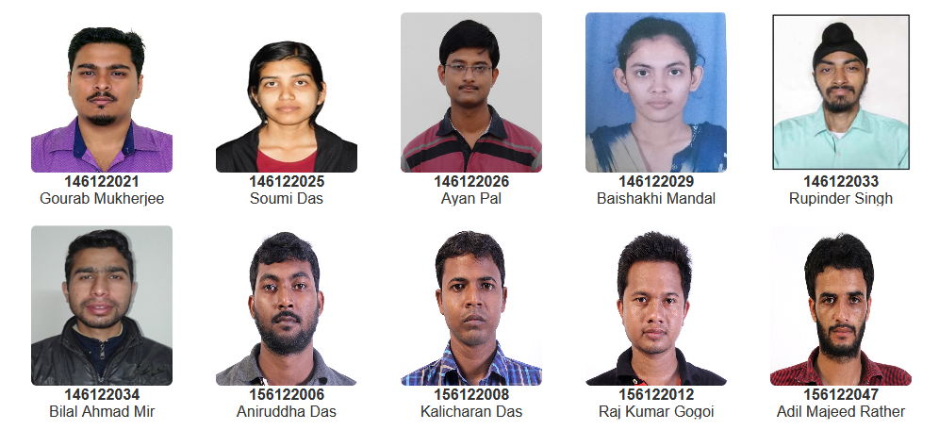
Dean of Academic Affairs
Prof. Chitralekha Mahanta
Doctor of Philosophy

Slide 26
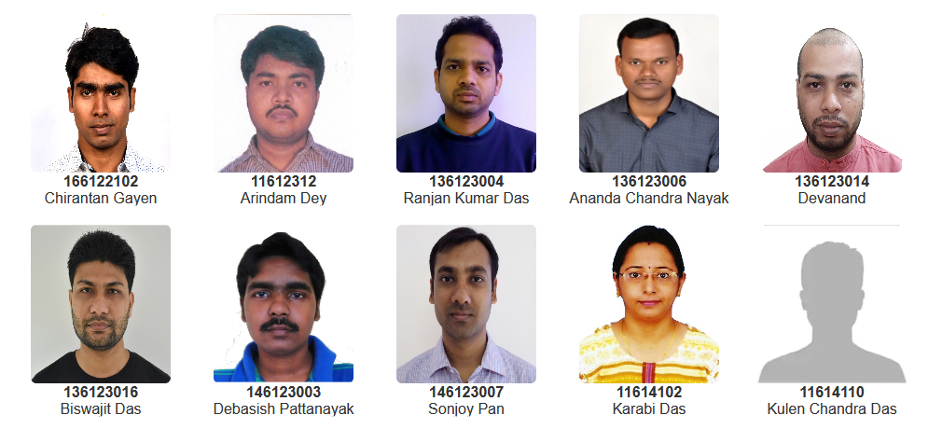
Dean of Academic Affairs
Prof. Chitralekha Mahanta
Doctor of Philosophy

Slide 27
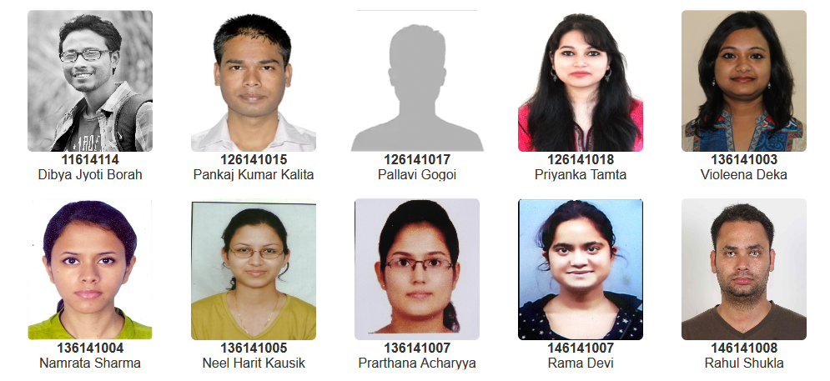
Dean of Academic Affairs
Prof. Chitralekha Mahanta
Doctor of Philosophy

Slide 28
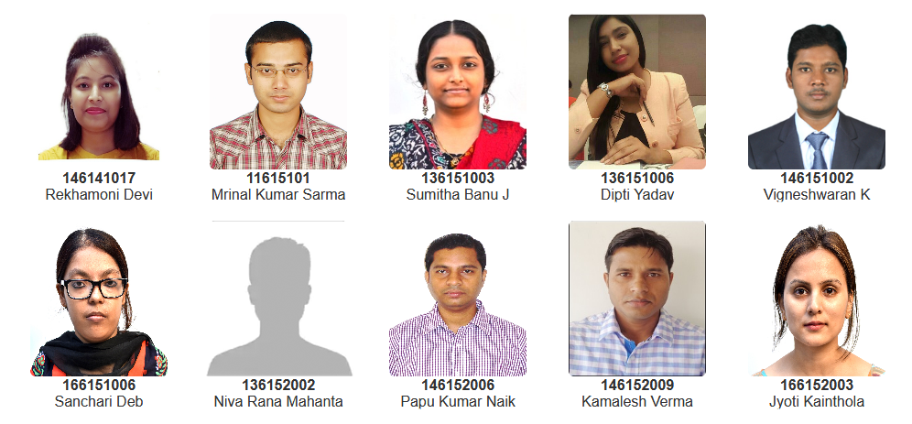
Dean of Academic Affairs
Prof. Chitralekha Mahanta
Doctor of Philosophy

Slide 29
Dean of Academic Affairs
Prof. Chitralekha Mahanta
Doctor of Philosophy

